Slide 1
Clinical challenge of acute pulmonary embolism diagnosis
Helia Robert-Ebadi
Division of angiology and hemostasis
Geneva University Hospitals and Faculty of Medicine
BELNUC Seminar Clinical challenges in the diagnosis and management of pulmonary embolism and the role of lung scintigraphy
Saturday 28th of September 2024
KU Leuven

Slide 2
Pulmonary embolism
A frequent disease
Incidence ∼ 1 : 1000
3^{d} cause of cardiovascular mortality
300’000 deaths / yr in the US
Tapson VF. NEJM 2008; 358:1037-1052

Slide 3
The first challenge of PE diagnosis
(and not the smallest)
Should I suspect PE in this patient?
Clinical symptoms and signs
lack diagnostic accuracy
Neither sensitive nor specific
http://www.onlymyhealth.com
https://www.pennmedicine.org

Slide 4
PE is usually suspected
Conjunction between :
A suggestive clinical presentation
The presence of venous thromboembolic risk factors
Situation (surgery, hosp, bedrest, etc)
Personal (pregnancy, hormone exposure, cancer, obesity, etc)
Familial (family history of venous thromboembolism)

Slide 5
The importance of differential diagnosis
Dyspnea and/or
Chest pain
(and/or syncope)
Other obvious explanation
No other obvious explanation
No clinical suspicion of PE
Clinical suspicion of PE
DO NOT TEST FOR PE
Start PE diagnostic strategy

Slide 6
How we would like it to be
Black or white, easy
positive
PE
PE suspicion
Test
negative
No PE
Pulmonary angiography
Invasive, high costs and radiation
Complications
N =1’111 patients in PIOPED study
Mortality related to angiography 0,5%
Major complications 1%
Stein et al. Circulation 1992;85:462-468

Slide 7
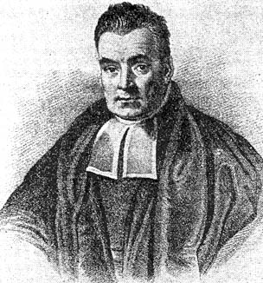
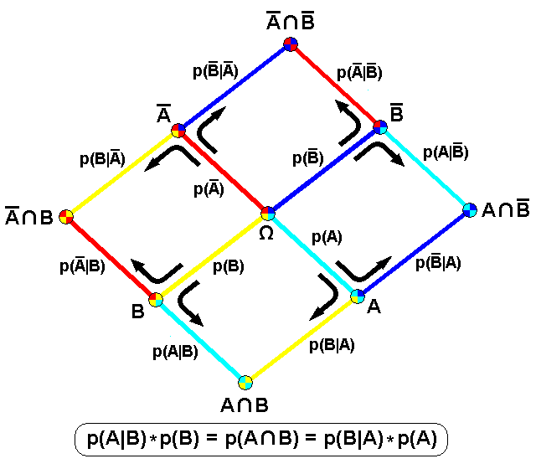
Reality …
A spectrum of greys
positive
Post-test probability of having
a PE
PE suspicion
Test
negative
Rev. Thomas Bayes
1702 - 1761

Slide 8
The first non-invasive imaging test for PE
PIOPED Investigators, JAMA 1990

Slide 9
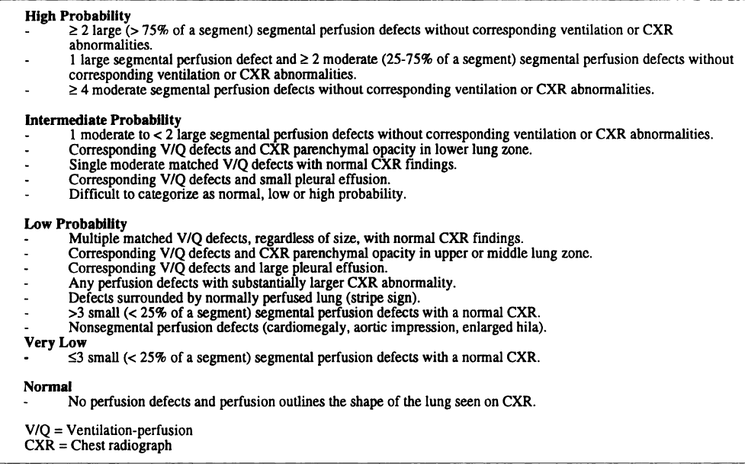
Reader agreement
Patients’ distribution
PIOPED study V/Q scan diagnostic criteria for PE
95%
13%
75%
39%
70%
+ Limited usefulness:
70% of tests were inconclusive for the patient
34%
92%
94%
14%
PIOPED Investigators, JAMA 1990

Slide 10
Diagnostic algorithms
Clinical probability
Low-intermediate / unlikely
High / likely
D-dimer
Negative
Positive
Investigations
STOP
Righini et al. JTH 2008; 6:1059-71

Slide 11
An important general consideration on the evolution of PE diagnosis
Non-invasive thoracic imaging tests are more and more readily available (especially CT pulmonary angiography)
Searching to confirm PE in
patients with a rather high suspicion
Willingness to exclude PE in
patients with chest symptoms

Slide 12
PE prevalence is reducing over time => the majority of patients with a clinical suspicion of PE do not have PE
30-40%
5-20 %
Evolution of diagnostic strategies → exclusion strategies
Dronkers et al. J Thromb Haemost 2017;15:2770-3

Slide 13
The safety of a diagnostic strategy in venous thromboembolism is assessed by the rate of VTE events occurring during the 3 months following exclusion of the diagnosis by the strategy, the so-called « failure rate »
A strategy is deemed to safely exclude PE if the 3-month VTE risk is < 2%
VTE risk after a normal angiography
1 - 2 %
Van Beek et al. Clinical Radiology 2001;56:838-842
Dronkers et al, J Thromb Haemost 2017

Slide 14
Diagnostic algorithms
Clinical probability
Low-intermediate / unlikely
High / likely
D-dimer
Negative
Positive
Investigations
STOP
Righini et al. JTH 2008; 6:1059-71

Slide 15
Typical distribution of outpatients with suspected PE Clinical probability categories and corresponding PE prevalences
Low | Intermediate |  | High
5-10% | 20-30% |  | 50-80%
Unlikely |  | Likely
≈ 15% |  | 35-40%

Slide 16
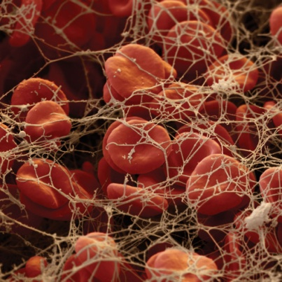
D-dimer : an exclusion test
ELISA tests (ex. VIDAS® cutoff 500ng/ml)
High sensitivity
Low specificity
Exclude DVT/PE in patients with a “non-high” clinical probability = low prevalence
High negative predictive value
≈ 100%
Di Nisio. JTH 2007;5:296-304 Ceriani et al. JTH 2010;8:957-70

Slide 17
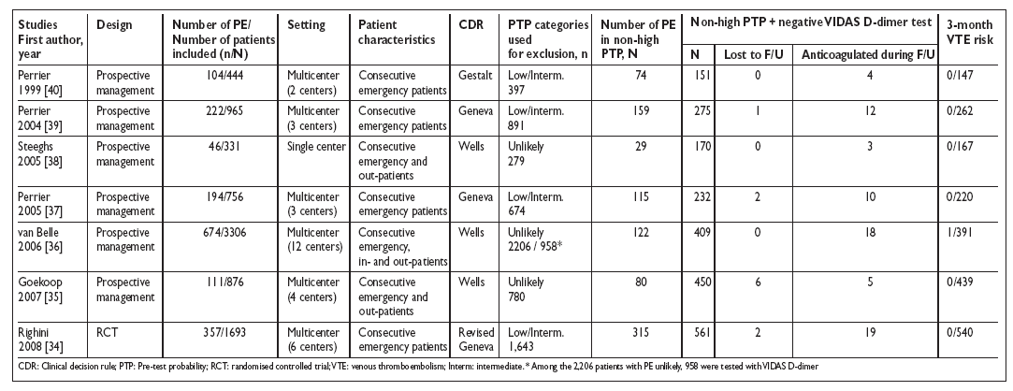
ELISA D-Dimer Assays – High sensitivity Safety in prospective management outcome studies
3-month VTE risk after a normal VIDAS D-dimer test
0.14% (95% CI: 0.05-0.41%)
Carrier et al. Thromb Haemost 2009;101:886-892

Slide 18
Clinical probability
Low-intermediate / unlikely
High / likely
D-dimer
Negative
Positive
Investigations
STOP
Diagnosis safely excluded in 1/3 patients
without any other additional test
NNT = 3
Perrier et al. Lancet 1999;353:190-5

Slide 19
Clinical probability
Low-intermediate / unlikely
High / likely
D-dimer
Negative
Positive
Investigations
STOP
Necessary in 2/3 patients

Slide 20
Multidetector computed tomography pulmonary angiography (CTPA) Diagnostic safety
Systematic review and metanalysis of
patients assessed with
Strategies using PTP/DD/CTPA
PE excluded by CTPA as the imaging test
Pooled 3-month VTE incidence
1.2% (95% CI 0.8-1.8)
Mos et al. JTH 2009; 7:1491-8.
Anderson J Emerg Med 2005; Ghanima JTH 2005; van Belle JAMA 2006; Perrier NEJM 2005; Anderson JAMA 2007; Righini Lancet 2008

Slide 21
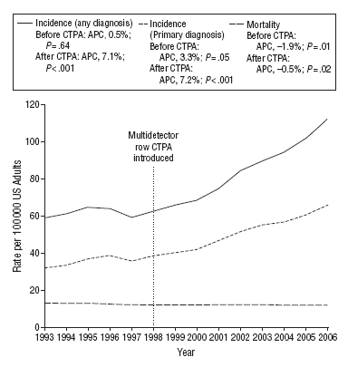
CTPA in PE diagnosis Overuse and overdiagnosis
Wiener et al, Arch Intern Med 2011; 171: 831-7

Slide 22
How to reduce CTPA use? Strategies to increase the diagnostic yield (“efficiency”) of D-dimer
Concept | Diagnostic strategy and D-dimer cutoffs | Yield of PTP+DD | Added yield | PE prevalence
Conventional strategies | PE excluded if negative DD in patients with a low/intermediate or unlikely PTP (Geneva / Wells) DD cutoff: 500 μg/L in all patients | 25-30%
Age-adjusted cutoff ADJUST-PE study | PE excluded if negative DD in patients with a low/intermediate or unlikely PTP (Geneva / Wells) DD cutoff: 500 μg/L up to 50 yrs, age x 10 in patients > 50 yrs | 35% | + 11% | 19%
CP-adjusted cutoff YEARS study | 3 items of Wells : signs of DVT, hemoptysis, PE most likely diagnosis DD cutoff: 1000 μg/L if no item, 500 μg/L if ≥ 1 item | 47% | + 13% | 13%
CP-adjusted cutoff PEGED study | Wells score with adapted thresholds DD cutoff: 1000 μg/L if low C-PTP (Wells 0-4), 500 μg/L if moderate C-PTP (Wells 4.5-6) | 66% | + 18% | 7.4%
Yield of PTP+DD = “diagnostic efficiency” = percentage of patients safely managed without CTPA
Added yield = absolute increase in the proportion of patients managed without CTPA compared to a conventional strategy in the same study cohort
Righini et al. JAMA 2014; 311:1117-1124. Van der Hulle et al. Lancet 2017;390:289-97. Kearon et al. NEJM 2019;381:2125-34.

Slide 23
How does all this translate into clinical practice?

Slide 24
Without PTP and D-dimer 100 patients with suspected PE

Slide 25
When using PTP and D-dimer
PTP assessment
+
D-dimer
CTPA
Given the frequency of chest symptoms and
The low prevalence of confirmed PE among suspected patients,
all safe strategies minimizing radiating tests and costs should be encouraged

Slide 26
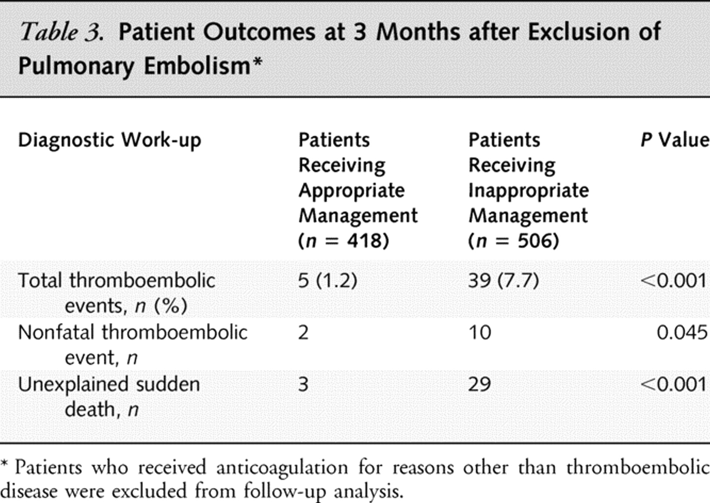
Using validated diagnostic algorithms with PTP + D-dimer
impacts patients outcomes
Roy PM et al. Ann Intern Med 2006;144:157-164.

Slide 27
What about nuclear medicine imaging?

Slide 28
Planar V/Q in PE diagnostic strategies
Patients suspects d’EP N =444
Probabilité clinique + DD
US de compression MI
Scintigraphie V/Q
N = 237
66% non-diagnostiques
(21% ont eu angiographie)
=11% de toutes les suspi d’EP
MTEV durant suivi 0.8%
(95% CI 0.9-3.1)
Perrier et al. Lancet 1999;353:190-5

Slide 29
What about nuclear medicine tests? SPECTACULAR study
Randomised, non-inferiority trial comparing 3 PE diagnosis strategies
Suspicion of PE
Randomisation
Diagnostic strategy with
V/Q SPECT
N = 1836
Diagnostic strategy with
CTPA
N = 918
Diagnostic strategy with
Planar V/Q
N = 918

Slide 30
Conclusions
Availability and technical developments of thoracic imaging tests should not lead us to forget that
the diagnosis of PE always relies on a clinical suspicion and a
DIAGNOSTIC STRATEGY
and not on a single test!
Clinical suspicion
Pre-test clinical probability
D-dimer using age-adjusted or probability-adapted cutoffs
Imaging

Slide 31
Thank you for your attention

Slide 32
L’IRM/ARM dans le diagnostic de l’EP Performance diagnostique
PIOPED III (ARM vs référence PC-DD-US-V/Q ou MDCT)
N = 371
ARM: techniquement inadéquat chez 25%
Parmi tests adéquats: Sn 78%, Sp 99%
Stein et al. Ann Intern Med 2010; 152: 434-443.
IRM-EP (patients PC-DD-référés pour MDCT 64-row→ IRM+ARM)
N = 300
IRM: techniquement inadéquat chez 30%
Parmi adéquats: Sn 79-84%, Sp 97-100%
Revel et al. JTH 2012; 10:743-50.

Slide 33
L’IRM/ARM dans le diagnostic de l’EP Utilité et performance diagnostique
Revue systématique et méta-analyse sur données individuelles
Examen techniquement inadéquat chez 19%
Sn globale 75% (IC 95%: 70-79%)
Sp globale 80% (IC 95%: 77-83)
Parmi tests adéquats: Sn 84%, Sp 97%
Zhou et al; JTH 2015; 13:1623-1634
IRM-EP 2 ongoing, NCT02059551
CDR-DD-MRI + lower limb CUS
Reference standard: MDCT + 3 month follow-up

