Slide 1







Lung Scintigraphy for Pulmonary Embolism Diagnosis
Pr Pierre-Yves SALAUN
pierre-yves.salaun@chu-brest.fr
BELNUC 2024
KULeuven
Notes:
It’s my great pleasure to present this talk on V/Q scintigraphy for pulmonary embolism diagnosis

Slide 2
Lung scan and PE
T0
3-6 Mo
Diagnosis
of acute PE
Initial
management
Follow up
Anticoagulation
V/Q scan
Notes:
As we will see, both diagnosis of PE and then the long term management of patients with confirmed PE remain a challenge for clinicians,
and in this talk we will review the current status and future perspectives of V/Q scintigraphy in these two main stages of the disease.
To begin, the most common clinical indication for V/Q lung scan is the diagnosis of acute PE

Slide 3
Diagnosis of acute PE
2 non-invasive imaging modalities
validated for PE diagnosis
Ventilation/perfusion scintigraphy
Functional consequences of the clot on lung perfusion
CT Pulmonary Angiography
Direct visualization of the clot
Notes:
There are currently 2 widely validated imaging modalities for PE diagnosis: V/Q scintigraphy and CT pulmonary angiography, which are based on a different approach:
V/Q scan allows a functional approach of showing the consequences of PE on lung perfusion,
whereas CTPA enables an anatomic approach of PE with the visualization of the clot itself.

Slide 4
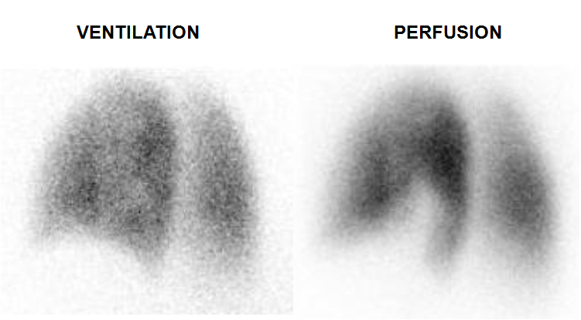
Ventilation/Perfusion Scintigraphy
Principle:
Ventilation: inhalation of inert gases (^{81m}Kr or ¹³³Xe) or ^{99m}Tc -labeled aerosols.
Perfusion: IV administration of ^{99m}Tc-labeled
macroaggregated albumin (MAA), which are trapped in the lung capillaries
Functional approach of PE : visualization of the functional consequences of the clot :
“Mismatched perfusion defect” = areas with absent perfusion but preserved ventilation
Notes:
We have to keep in mind that V/Q planar scan was the first non invasive test validated for PE diagnosis, in replacement of pulmonary angiography.
Ventilation is acquired after inhalation of inert gases, such as Krypton in Europe or Xenon in the US, or radiolabeled aerosols, mainly technegas with an newly FDA approvment last year in US
Perfusion is imaged after intravenous administration of radiolabeled macroaggregated albumin particles, which are trapped in the lung capillaries according to the regional blood flow.
This may seem trivial, but it’ s important to recall that the hallmark of PE with V/Q scan, is the mismatched perfusion defect, that is areas with absent perfusion but preserved ventilation.
This pattern, the mismatched perfusion defect is very specific of PE, acute or chronic,

Slide 5
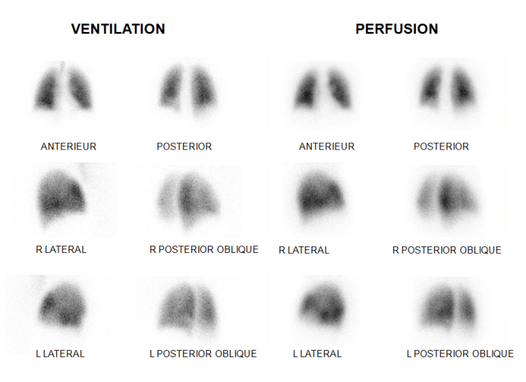
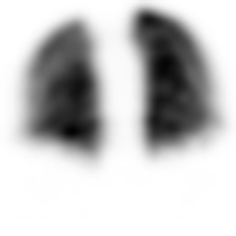
Ventilation/Perfusion Scintigraphy
V/Q PLANAR
« 2D » imaging
Different
acquisition protocol
V/Q SPECT
« 3D » imaging
Notes:
As you know, 2 different protocols are possible for image acquisition, planar 2D imaging focusing different incidences or SPECT imaging allowing 3D imaging.
Let’s start by conventional planar V/Q scan.

Slide 6
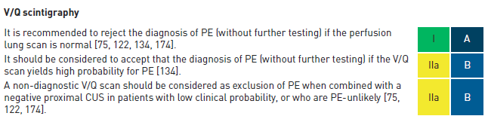
Planar V/Q scintigraphy for acute PE
PIOPED investigators, JAMA 1990
Interpretation according to the number and size of mismatched defects :
Normal PE excluded
High prob PE confirmed (controversial if low clinical prob)
Low prob
Interm prob
« Inconclusive » tests → further testing (CUS)
(>40% in the PIOPED study)
Konstantinides SV, Eur Respir J 2019
Notes:
Interpretation is based on the number and size of defects, and when using planar V/Q scan, results are classified according to the criteria established in the PIOPED study, which have been revised and simplified.
Basically, results can be classified in 3 categories:
Normal perfusion scan, which rules out PE diagnosis.
High probability scan, more than 2 segmental mismatched perfusion defects, which confirms PE diagnosis in most of patients.
And between these two categories, the low and intermediate probability scans, which are usually combined in a single category, reported as non conclusive, for which further testing is required.

Slide 7
Planar V/Q scintigraphy for acute PE
Planar V/Q scan
  Anderson DR. JAMA. 2007
Normal
« Inconclusive »
High
Lower limb CUS
Negative
Positive
PE unlikely or negative D-Dimer
PE likely and positive D-Dimer
Serial CUS
No PE
Treat
Notes:
Here is an example of a validated diagnostic algorithm for PE diagnosis using planar V/Q scan.
Again, if the V/Q is normal, PE can be ruled out,
if there is a high probability V/Q scan, PE is confirmed
And in patients with an inconclusive V/Q scan, a lower limb compression ultra sonography is usually performed, which allows, in combination with the clinical probability to conclude in a majority of patients.

Slide 8
Planar V/Q scintigraphy for acute PE
Lower limb CUS (321)
Negatif (278)
Positif (43)
Planar VQ scan (PIOPED)
Normal (46)
Low (156)
Clin P
Intermediate(21)
Clin P
high (54)
Clin P
Low/Int
143
high
14
low
8
Int/high
13
low
8
Int/high
46
CT, 35 (11%)
Negatif, 23
Not done, 3
Positif, 9
EP excluded (220)
no treatment
EP confirmed
(98)
8
3 mo VTE Risk
0,5% (0,1-2,9)
8

Slide 9
Planar V/Q scintigraphy for acute PE
Diagnostic strategy using V/Q planar scan :
Complex, difficult to apply
but…
Strongly validated for excluding PE in several large management outcome studies
  Wells PS. Ann Intern Med 1998
  Perrier A. Lancet. 1999
  Anderson DR. JAMA. 2007
Notes:
So, obviously, the main constraint of diagnostic strategies using the planar V/Q scan is that they are complex and possibly difficult to apply.
But, on the other hand, it is important to remember that these strategies have been strongly validated for excluding PE in several large management outcome studies, published in…
So in other words, it works well and it is safe to manage a patient with suspected PE using a validated strategy based on the V/Q planar scan.

Slide 10
CTPA vs planar V/Q scan?
Anderson, JAMA 2007
1417 patients with suspected PE
Diagnostic strategy based on
CTPA
Diagnostic strategy based on
V/Q planar scan
3-month risk of VTE: 0,4% 0.8% (NS)
PE prevalence : 19,2% 14,2%
+35% PE with CTPA : false positive? non clinically relevant PE?
Notes:
Also, there is an increasing concern in the literature about the risk of over-diagnosing PE when using CTPA, especially because we trend towards extended duration of treatment.
In this randomized clinical trial, which is currently the only one that directly compared a CTPA based strategy and a V/Q planar based strategy, Anderson et al. did not show significant difference between the two strategies in terms of diagnostic exclusion safety, however the CTPA based strategy led to a 35% higher rate of PE diagnosis.
This likely means that a significant proportion of PE diagnosed when using CTPA are false positive results or not clinically relevant.

Slide 11
CTPA vs planar V/Q scan?
24,871,131 New York inpatients
1994-2004
PE diagnosis doubled over time,
without relationship to PE risk factors
PE mortality stable
No association between increased PE diagnosis and mortality
Burge Clinical Radiology 2008
Notes:
Several cohort studies also strengthen this idea.
With an increase in the number of PE diagnosed with the advent of CTPA, but with no change in PE mortality, suggesting that the extra PE being detected are less lethal.

Slide 12
CTPA vs planar V/Q scan?
2087 pts with PE 2000-2007
Outcome: PE mortality
CT vs VQ for diagnosis
Sheh SH et al. AJR 2012
PE diagnoses increased (p < 0.001) -mirroring CT utilization
PE mortality rate constant
Notes:
Several cohort studies also strengthen this idea.
With an increase in the number of PE diagnosed with the advent of CTPA, but with no change in PE mortality, suggesting that the extra PE being detected are less lethal.

Slide 13
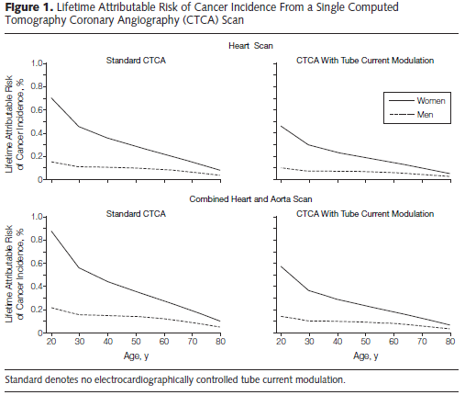
CTPA vs planar V/Q scan?
A woman undergoing a CTPA at the age of 20 could have a 0.5% absolute increase in her lifetime risk of breast cancer
V/Q scan is about 30% of the dose of a CTPA and only 3% of the dose to the breast
Einstein AJ, JAMA 2007
Notes:
Another advantage of the V/Q scan over CTPA is the radiation dose. There is an increasing concern with the radiation dose to the breast with CTPA, particularly in young women.
Some studies suggest that a woman undergoing a CTPA at the age of 20 could have a 0.5% absolute increase in her lifetime risk of breast cancer.
The dose of a V/Q scan is about 30% of the dose of a CTPA and only 3% of the dose to the female breast.

Slide 14
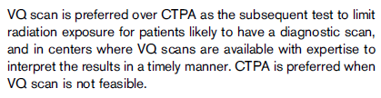
CTPA vs planar V/Q scan?
Lim W, Blood Adv 2018
Notes:
For these reasons, the recent American Society of Hematology (ASH) guidelines for VTE diagnosis state that V/Q scan is to be preferred over CTPA to limit radiation exposure in some groups of patients who are likely to have a diagnostic scan.

Slide 15
Planar V/Q scintigraphy for acute PE
Strengths
Strongly validated in prospective management outcome studies
No contraindication (allergy, renal failure)
Low radiation dose, especially to the female breast
Limitations
High rate of inconclusive results
Complex diagnostic algorithms
No alternative diagnoses
Availability
Notes:
To summarize, what are the strengths and weakness of planar V/Q scan? Especially as compared with CTPA
Strengths include :
A strong validation in prospective management outcome studies.
No contraindication or side effect
Low radiation dose, especially to the female breast.
On the other hand, the main limitations are
the high rate of inconclusive results, resulting in complex diagnostic algorithms
V/Q planar scan does not allow to propose alternative diagnosis
And the test is not available everywhere.

Slide 16
Ventilation/Perfusion Scintigraphy
V/Q PLANAR
« 2D » imaging
Different
acquisition protocol
V/Q SPECT
« 3D » imaging
Notes:
Now let’s move on to SPECT/CT imaging

Slide 17
V/Q SPECT/CT for acute PE
Technical advantages of SPECT :
Eliminate overlap of activities
Better characterization of defects : location, size, shape
Medial-basal segment
Co-registration with a low dose CT
Correlation with morphologic features on CT
Differential diagnosis
Notes:
By using 3D imaging, V/Q SPECT has an inherent technical advantage over conventional 2D planar, though its ability to eliminate overlap of activities; to better characterize the size, shape, and location of defects, to visualize the medial-basal segment.
Furthermore, simultaneous acquisition of a low dose CT allows for correlation of V/Q defects with morphologic features on CT, and allows for differential diagnosis.

Slide 18
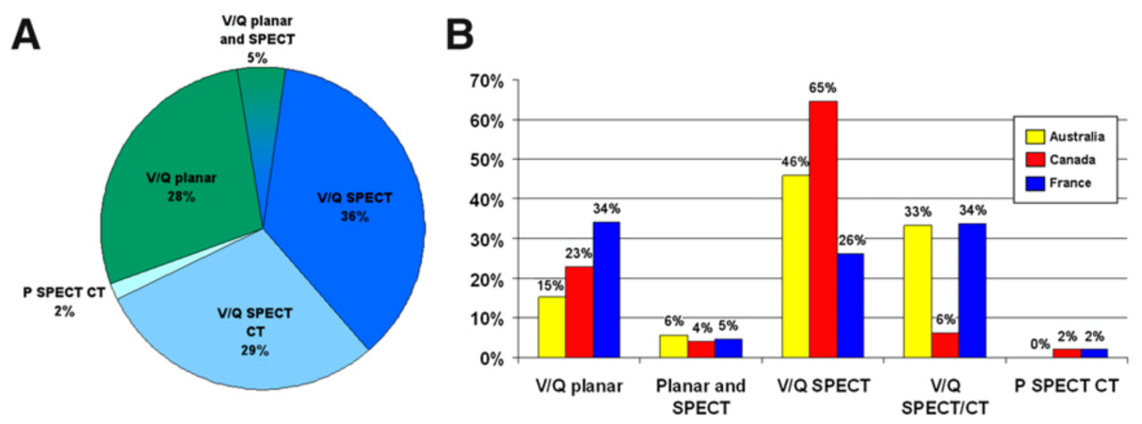
V/Q SPECT/CT
331 nuclear medicine departments in Australia, France and Canada, 2014
> 2/3 departments: SPECT imaging
< 10% departments: Planar/PIOPED
Le Roux PY . J Nucl Med 2015
Notes:
V/Q SPECT has already been widely adopted for PE diagnosis in countries where ^{81m}Kr gas or Technegas were available
In a survey performed among more than 300 facilities from Australia, Canada, and France, already back 8 years ago, more than two-thirds of centers performed SPECT rather than planar images for PE diagnosis.
This is likely less in the US where ^{81m}Kr gas or Technegas were not available.

Slide 19
V/Q SPECT/CT
465 nuclear medicine departments in Australia, Canada, France, Germany and USA, 2023
Le Pennec R . Clin Nucl Med 2024
Notes:
V/Q SPECT has already been widely adopted for PE diagnosis in countries where ^{81m}Kr gas or Technegas were available
This is likely less in the US where ^{81m}Kr gas or Technegas were not available.

Slide 20
V/Q SPECT/CT interpretation
Binary interpretation: “POSITIVE” or “NEGATIVE” for PE
Rational:
- Higher diagnostic performance of SPECT vs planar.
- Ease of use for nuclear medicine physicians.
- Greater understanding of clinicians.
- Simplification of diagnostic strategies.
Notes:
A binary reporting approach for interpreting a V/Q SPECT/CT as positive for PE is widely accepted.
The rational for transitioning from the probabilistic to the binary approach is
- the higher diagnostic performance of SPECT
- The ease of use for nuclear medicine physicians.
- A greater understanding of clinicians.
- the aim of simplifying diagnostic strategies.

Slide 21
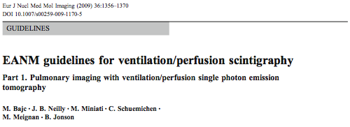
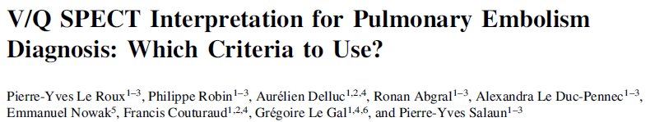
V/Q SPECT/CT interpretation
Binary interpretation: “POSITIVE” or “NEGATIVE” for PE
1 segmental or 2 sub-segmental mismatched perfusion defects
Notes:
A diagnostic cut-off of 1 segmental or 2 subsegmental mismatched defects is widely used.
This threshold was initially proposed in the EANM guidelines for V/Q scintigraphy in 2009, it was shown to provide optimal sensitivity and specificity.
And was already the most commonly used criteria in our survey.

Slide 22
V/Q SPECT/CT interpretation
Caution to the risk of false positive!
V/Q SPECT :
  More sensitive to regional lung function heterogeneities.°
  Lower threshold (1segt in comparison vs 2 segts for a planar high probability) ➔ ↑ Sensitivity
Literature
  Observational studies : VTE event at 3 Mo < 3%
    Bajc M J Intern Med 2008
    Le Roux PY Eur J Nuc Med imaging 2014
    Truffault B Nucl Med Comm 2019
  But (too?) high prevalence of PE
    Gutte. J Nucl Med 2009, 81 pts, PE prevalence : 38%
    Bajc. J Intern Med 2008 : 1785 pts, PE prevalence, 34%
    Le Roux. Eur J Nucl Med 2014 : 393 pts, PE prevalence : 28%
    Grüning. Clin Imaging 2014 : 1406 pts : PE prevalence : 24%
    Dronkers. J Thromb Hamost : 49 included studies contained 29 684 patients
    Pooled PE prevalence 22.6% (95%CI 22.5–22.7)
Notes:
However, I think we need to pay attention to the risk of false positive with the V/Q SPECT.
Indeed, V/Q SPECT is more sensitive to regional lung function heterogeneities, and the threshold used with V/Q SPECT (1segment) is lower than the two segments required for a high probability planar V/Q scan,
this likely makes V/Q SPECT a more sensitive test than planar imaging.
Furthermore, if we look at the literatures,
V/Q SPECT seems to be safe to rule out PE with, in all observational studies, a low rate of VTE event in patients left untreated based on a negative V/Q SPECT.
But the prevalence of PE across studies on V/Q SPECT may seem a bit high.
24, 28, 34, 38%, there may be selection bias, but it‘s a bit high as compared with studies using other imaging tests, in a recent meta analysis in 30000patients, the pooled prevalence was 22.6%.

Slide 23
V/Q SPECT/CT
Co-registration with a low dose CT to increase the specificity
Notes:
In order to increase the specificity and decrease the rate of false positive results, SPECT images can be combined with a low-dose CT that may visualize non-PE findings which may explain perfusion defects.
Here is an example of a patient with suspected PE, SPECT images showed a segmental perfusion defect in the RUL, with relatively preserved ventilation. Just based on V/Q SPECT images, the scan would have been read as positive for PE. However, the CT scan showed parenchymal lesions which were actually radiation changes.

Slide 24
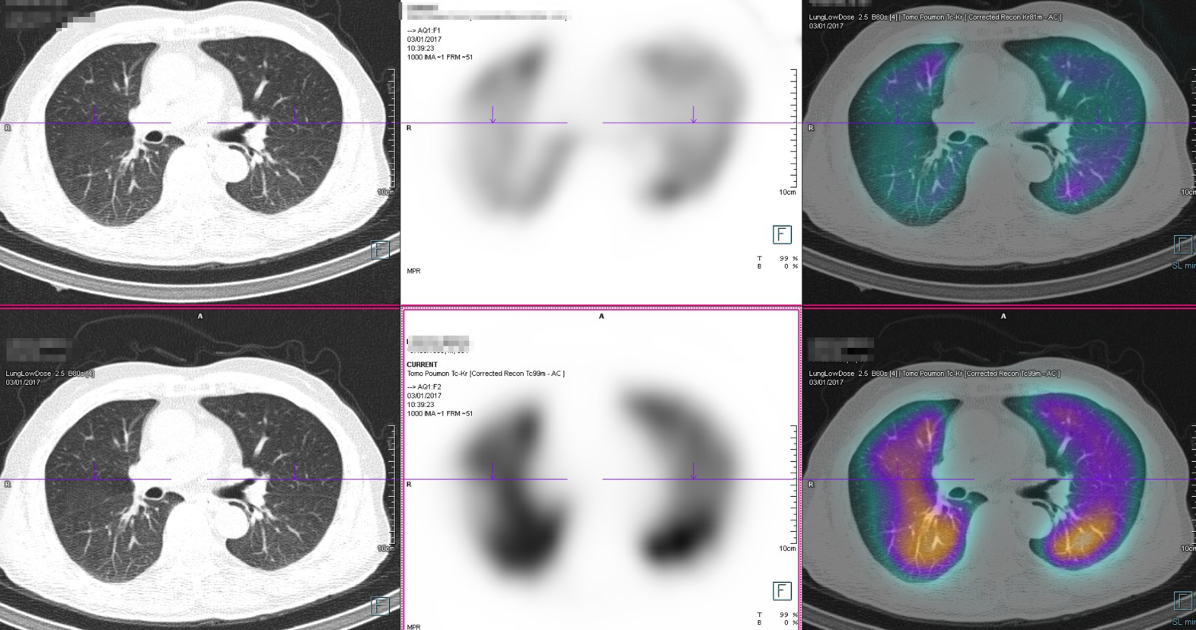
V/Q SPECT/CT
Co-registration with a low dose CT to increase the specificity
Notes:
Here is another example of a patient with a defect in the right lung on perfusion SPECT images, not clearly seen on ventilation SPECT.
However, the low dose CT allows to locate the fissure in this territory.

Slide 25
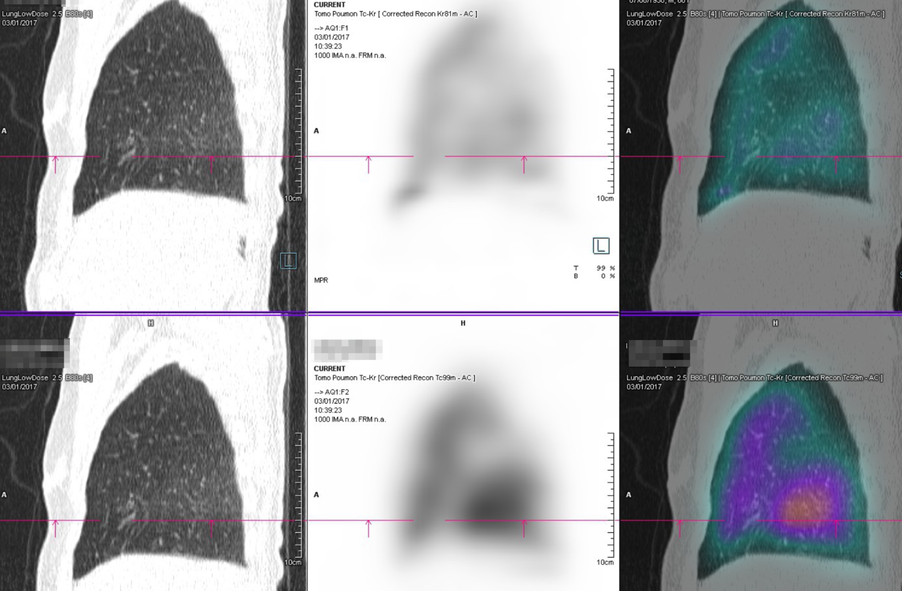
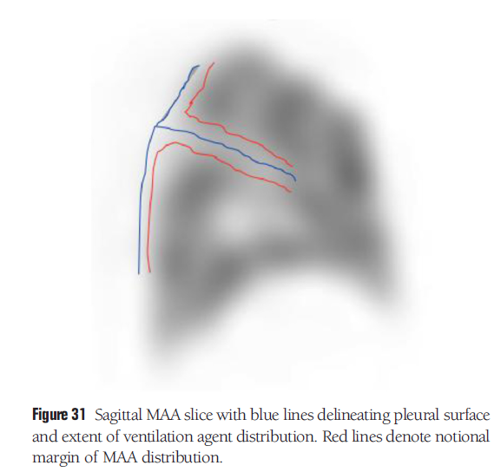
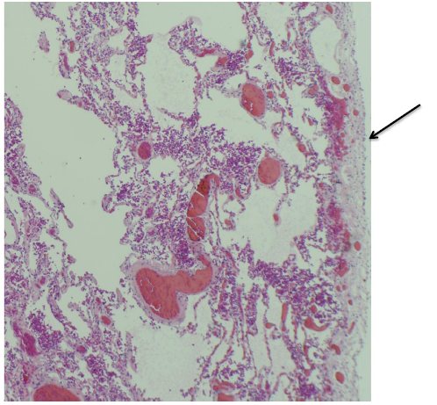
V/Q SPECT/CT
“Fissure sign”
Schembri GP Semin Nucl Med 2015
Notes:
This was more readily identifiable on the sagital views, and again the CT scan was very helpful to locate both right fissures and confirmed what was called by Schembri and colleagues the « fissure sign », which is frequently on SPECT imaging.
So a more pronounced perfusion defect observed along all or part of the anatomical fissure line.

Slide 26
V/Q SPECT/CT interpretation
Q SPECT/CT without ventilation?
High risk of false positive when substituting ventilation images by a low dose CT scan
Gutte H J Nucl Med 2009
Palmowski K Respiration 2014
Le Roux PY. Nucl Med Comm 2015
Notes:
On the other hand, low dose CT should not replace the ventilation scan.
For example, this perfusion SPECT scan demonstrates multiple perfusion defects, without significant abnormalities on CT, so by omitting the ventilation, the scan would be positive for PE.
While all perfusion defects were actually matched with ventilation defects.
So there is a high risk of false positive when substituting ventilation images by a low dose CT scan, in the series it’s up to 20% of negative V/Q SPECT that would be falsely positive by replacing the ventilation SPECT by a low dose CT.

Slide 27
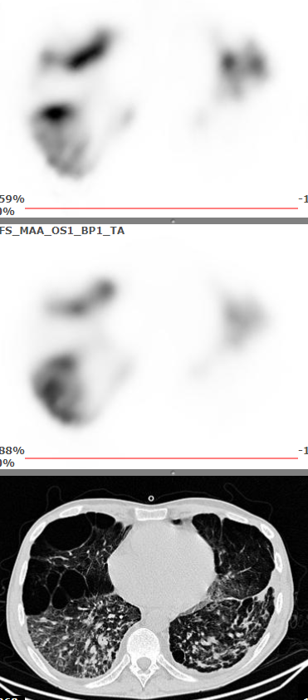
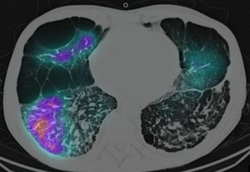
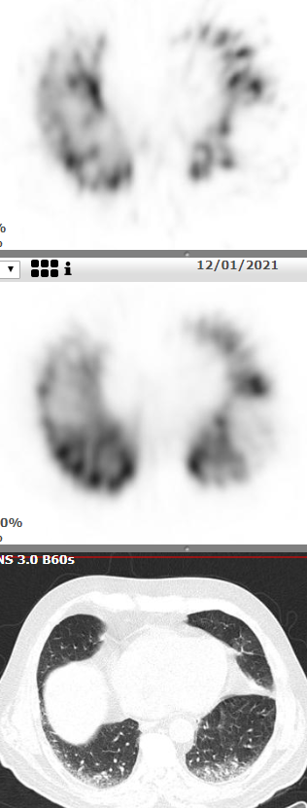
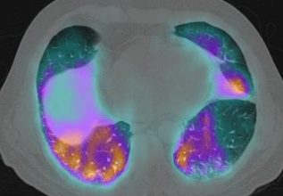
Lung scan in COVID-19 patients
Examples of positive Q SPECT/CT but negative V/Q SPECT/CT
Le Roux J Nucl Med 2022
Notes:
Omitting the ventilation was proposed especially during the COVID-19 pandemic, to limit the potential risk of contamination with the ventilation procedure.
But again, there was a high risk of false positive results.
Here are 2 other examples of PE suspicion in patients with COVID-19 disease.
For both patients, perfusion SPECT images showed perfusion defects without significant abnormality on CT images.
P SPECT/CT scans would therefore have been read as positive for PE.
However, the V scan demonstrated matched defects. V/Q SPECT/CT scans were therefore interpreted as negative for PE.

Slide 28
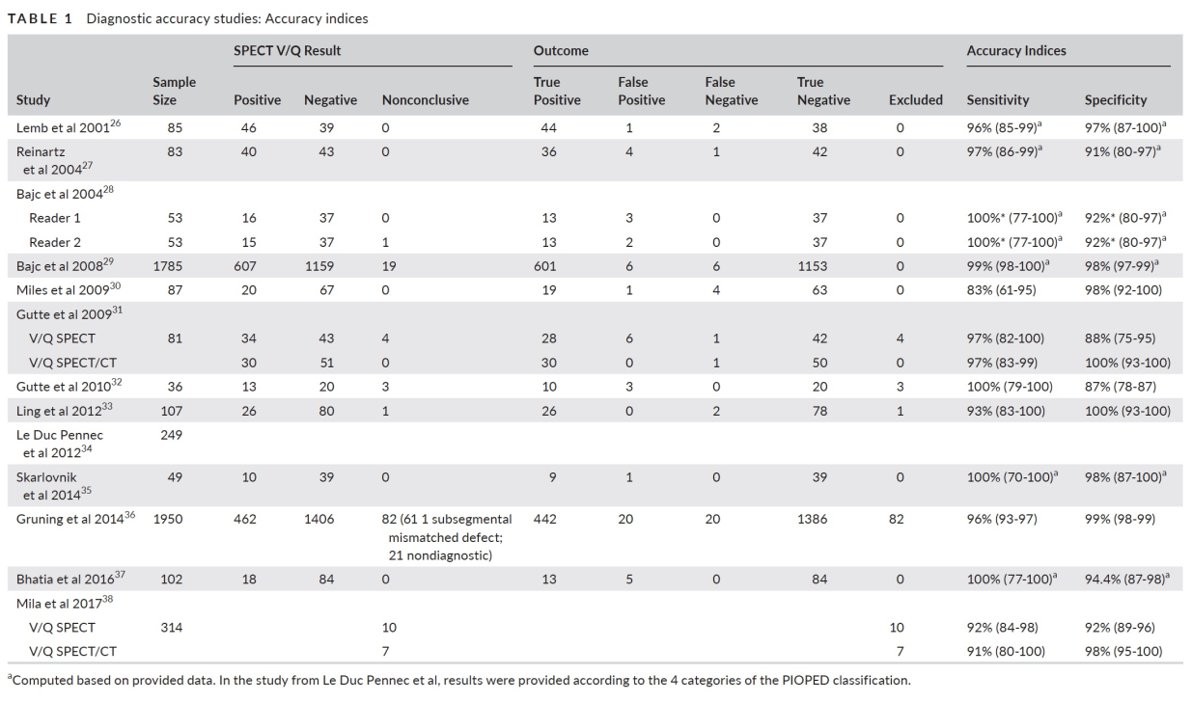
V/Q SPECT/CT
Diagnostic accuracy?
Diagnostic accuracy :
Se: 83% to 100%
Sp: 87% to 100%
Le Roux PY. J Thromb Haemost 2020
Notes:
What is the diagnostic performance of V/Q SPECT/CT imaging?
We recently conducted a systematic review on V/Q SPECT for PE diagnosis.
And the accuracy indices were high, ranging from 83 to 100% for sensitivity and 87 to 100% for specificity.

Slide 29
V/Q SPECT/CT
But…
No prospective management outcome study
- No randomized trial comparing with other modalities
Le Roux PY et al. J Thromb Haemost 2020 Konstantinides SV, Eur Respir J 2019
Notes:
However, there is currently no prospective management outcome study and no randomized trial comparing with other modalities.
So there is currently no validated diagnostic algorithm with the V/Q SPECT, which likely explains why the clinical guidelines remains cautious with the V/Q SPECT.

Slide 30
V/Q SPECT/CT
Ongoing RCT
PE suspicion
Randomisation
Diagnostic strategy based on
V/Q SPECT
Diagnostic strategy based on
CTPA
Diagnostic strategy based on
V/Q Planar scan
Outcomes:
  Diagnostic safety (3-month risk of VTE)
  Proportion of confirmed PE (?overdiagnosis)
NCT02983760
Notes:
In that respect, our group is currently conducting a randomized multicenter control trial in patients suspected of having acute PE, comparing 3 diagnostic strategies for PE diagnosis, based on V/Q SPECT, V/Q planar, and CTPA.
The aim of the study is to ensure that a diagnostic strategy based on V/Q SPECT is non inferior to previously validated strategies to rule out PE; but also to detect potential overdiagnosis using one of the imaging modalities, by comparing the proportion of patients diagnosed with PE with each groups.

Slide 31
V/Q SPECT/CT
Strengths
No contraindication (allergy, renal failure)
Low radiation dose, especially to the female breast
Alternative diagnosis
Low rate of inconclusive test
Simple diagnostic algorithm?
No overdiagnosis?
Limitations
Availability
Not validated in management outcome study
Notes:
So to conclude with the V/Q SPECT, it is a promising alternative to CTPA and planar V/Q, with several advantages including
No contraindication
Low radiation dose.
Possibility to provide alternative diagnosis with the low dose CT
Low rate of inconclusive test
Potentially simple diagnostic algorithm and no overdiagnosis? But of course it has to be evaluated.
On the other hand, the test is less available than CTPA and there is currently no validated management outcome study.

Slide 32
Pregnancy
Diagnosis of PE during pregnancy :
PE is a major complication of pregnancy and a leading cause of maternal mortality.
Radiation exposure :
  Fetal : lung scan and CTPA well below 100mSv
  Maternal : CTPA > lung scan
Notes:
Just a word on a specific situation, PE suspicion during pregnancy.
PE is a major complication of pregnancy and a leading cause of maternal mortality.
An important consideration is the radiation exposure of the scans.
The radiation to the fetus is well below the safety threshold for both scans.
However, the radiation dose to the breast is higher with CTPA. Because the breast tissue is particularly radiosensitive during pregnancy, the risk of radiation-induced breast cancer is of particular concern in pregnant women.

Slide 33
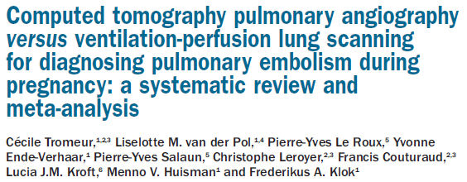

Pregnancy : CTPA vs lung scan
Normal perfusion scan and negative CTPA equally safe for ruling out PE
Similar rates of non-diagnostic results : CTPA 12% vs 14% perfusion scan
Majority of guidelines recommend the use of lung scintigraphy rather than CTPA in pregnant women
Notes:
Both CTPA and lung scintigraphy are equally safe to rule out PE in pregnancy.
In a recent systematic review and meta-analysis, the pooled rate of false negative test results was 0% for both tests.
Furthermore, and in contrast with the non pregnant population, the pooled risks of a non-diagnostic test for both CTPA and V/Q planar scan was comparable, 12% for the CTPA and 14% for the V/Q scan.
Indeed, the risk of non-diagnostic tests with CTPA is relatively high in pregnant women, because of the hemodynamic changes that occur during pregnancy.
In contrast, as compared with the general population, young women are less likely to have parenchymal lung disease and a non-diagnostic perfusion lung scintigraphy.
So, given that both scans have similar diagnostic performance and similar rate of non diagnostic results, and that the radiation dose is higher with CTPA, with suspected PE, which explains why a majority of guidelines recommend the use of lung scintigraphy rather than CTPA in this population.

Slide 34
Conclusion
T0
3-6 Mo
Diagnosis
of acute PE
Initial
management
Follow up
Anticoagulation
V/Q scan
High diagnostic performance
Radiation dose/Overdiagnosis
V/Q SPECT/CT :
decrease the proportion of non diagnostic test
simplify the diagnostic algorithms
differential diagnosis.
Notes:
To conclude,
V/Q scintigraphy still has a major role to play for the diagnosis of acute PE, with especially an advantage on the radiation dose and possibly on the risk of overdiagnosis.

Slide 35



Thank you !
Notes:
To conclude,
V/Q scintigraphy still has a major role to play for the diagnosis of acute PE, with especially an advantage on the radiation dose and possibly on the risk of overdiagnosis.

Slide 36
Pregnancy
Acquisition protocol?
Low prevalence of confirmed PE among women investigated : 2-7%.
Young women: less likely to have parenchymal lung disease
Planar perfusion scan normal in 90% of cases, which allows to safely rule out PE.
If the perfusion scan abnormal : a ventilation scan is required.
Priority : diagnostic certainty >> radiation exposure/side effects
Notes:
What acquisition to perform?
Because symptoms of PE frequently overlap with those of normal pregnancy, the prevalence of PE among pregnant women tested is low, approximately 2-7%.
And young woman are less likely to have parenchymal lung disease
As a result, the perfusion scan is normal in 90% of cases.
Accordingly, in order to reduce radiation exposure in pregnant patients, most of nuclear medicine physicians only performed a perfusion scan in first intention, in pregnant woman, and only performed a ventilation scan in a second time when necessary.
Anyway, given the potential consequences of a false positive and negative diagnosis in a pregnant woman with suspected PE, priority should always be given to the diagnostic certainty over the radiation exposure.

