Slide 1
Clinical challenges of long-term management after an acute pulmonary embolism
Prof. Grégoire Le Gal
Thrombosis Unit, Division of Hematology
University of Ottawa, Canada

Slide 2
PE management: at the acute phase
Risk stratification
Hemodynamic instability?
Biological or echocardiographic signs of right ventricular dysfunction?
Outpatient management vs. admission vs. ICU admission
Thrombolytic therapy for unstable patients
Catheter directed lytic therapy in selected cases
Anticoagulation
Direct oral anticoagulants for most patients
Heparin (LMWH) with transition to warfarin still used in some patients (renal failure, major drug interactions, extreme body weights, etc.)

Slide 3
For how long should we treat?
One of the most debated questions in the field of thrombosis
Previous paradigm: acute, curable disease, requiring a (relatively) short course of anticoagulant therapy

Slide 4
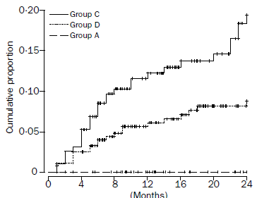
Duration of treatment
Cohort study, 570 patients with a first episode, treated for 6 months, then stopped
4 groups
A: surgery < 6 weeks
D: estrogen, lower limb trauma, acute illness, long travel
C: no risk factor
Baglin Lancet 2003;352:523-6.

Slide 5
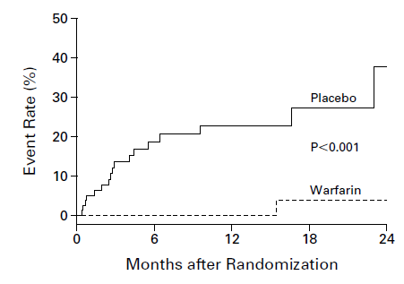
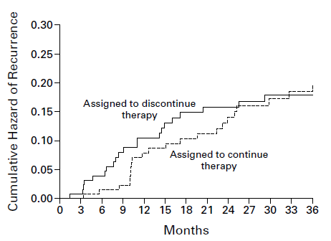
Duration of treatment, unprovoked VTE
Treat for longer?
But for how long?
Kearon, N Engl J Med 1999;340:901-7.
Agnelli, N Engl J Med 2001; 345: 165-9.

Slide 6
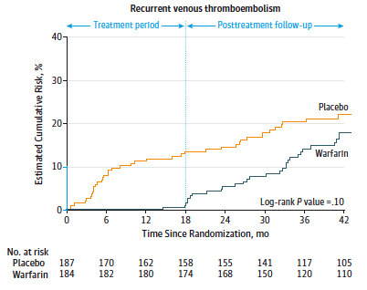
Duration of treatment, unprovoked VTE
In patients with no provoking risk factors, anticoagulant therapy delays, but does not prevent, recurrent events
Treat short… or indefinitely
Couturaud, JAMA 2015;314:31-40.

Slide 7
Surgery
Admission with immobilization
C-section
Estrogen contraceptives
Pregnancy
Long travel
Lower limb trauma
Active cancer
Antiphospholipid antibodies
Kearon, J Thromb Haemost 2016; 14: 1480-3.; Stevens, Chest, doi.org/10.1016/ j.chest.2021.07.056

Slide 8
Duration of treatment, risk stratification
Beyond the presence of major risk factors, some predictors have been identified
D-dimer after initial treatment
Age
Obesity
Residual PE?
Could V/Q scan be used to improve risk stratification?
Post-thrombotic syndrome
Male gender
Robin P. et al, J Thromb Haemost 2023;21:1519-1528.

Slide 9
End-of-treatment (baseline) imaging
Baseline imaging as a risk stratification for the risk of recurrent events?
Baseline imaging as a reference in case of future suspected recurrent event?
Role of imaging in patients with persistent symptoms?

Slide 10
Baseline imaging and suspected recurrence
After discontinuing anticoagulation, one third of patients will come back during the following year for a suspected recurrent event
Challenging situation clinically
Residual symptoms vs. fear from recurrence vs. new PE
Non-invasive tests (pretest probability, D-dimers) are less likely to rule out PE
Residual thrombi from previous episode are common (∼50%) and could lead to falsely positive imaging test interpretation
Critical not to overdiagnose: a recurrent PE is a life sentence to anticoagulation!!
Comparing V/Q scan to baseline imaging helps identifying true recurrent events
Le Gal, J Thromb Haemost 2009; 7: 752-9.
Le Gal G, J Thromb Haemost 2009; 7: 752–9.

Slide 11
Baseline imaging and persistent symptoms
Many PE survivors have persistent symptoms after a first PE, mainly shortness of breath
Fear of recurrence?
Deconditioning?
Chronic thromboembolic disease
Chronic thromboembolic pulmonary hypertension (<5%)
Echocardiography and V/Q scan are first-line imaging tests to rule out alternative diagnoses and screen for CTED / CTEPH: when to do? Which modality? Which interpretation criteria?

Slide 12
Summary
Venous thromboembolism is a chronic disease
Long-term anticoagulation is effective but is associated with costs, side effects, disadvantages
Repeated V/Q scan is helpful for the diagnosis of recurrent events, the screening for post-PE complications, and could help with risk stratification

Slide 13
Thank you!

