Slide 1



Lung Scintigraphy for long term management of PE
Pr Pierre-Yves Le Roux
pierre-yves.leroux@chu-brest.fr
BELNUC
LENVEN
28 September, 2024

Slide 2
Lung scan and PE
T0
3-6 Mo
Diagnosis
of acute PE
Initial
management
Follow up
Anticoagulation
V/Q scan?

Slide 3
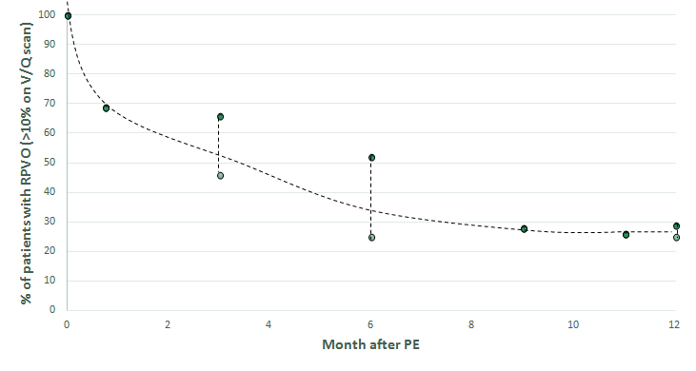
Residual pulmonary vascular obstruction
Residual pulmonary vascular obstruction (RPVO)
= Incomplete repermeabilization of the pulmonary arteries after acute PE.
RPVO: 30-50% of patients after 3-6 months of anticoagulation
Bonnefoy PB. Thromb Res 2019

Slide 4
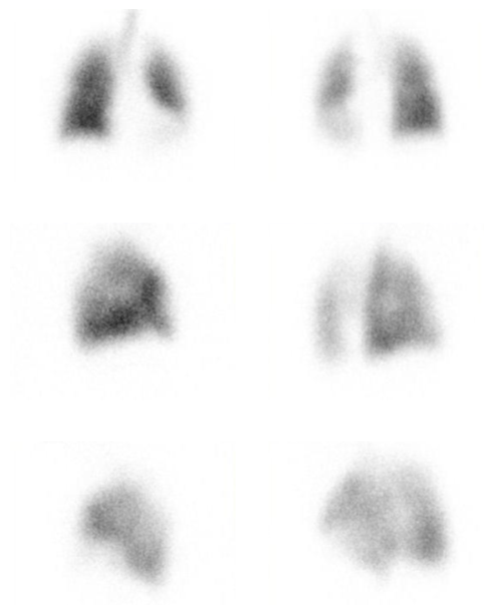
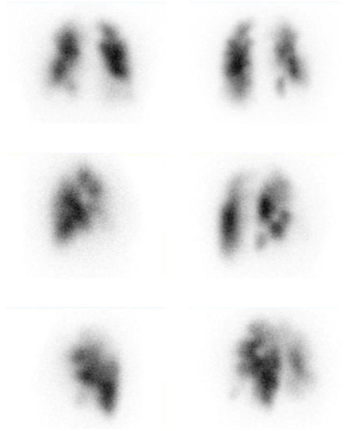
Residual pulmonary vascular obstruction
Post-embolic sequelae :
Same pattern as acute PE : Mismatched perfusion defect
Ventilation
Perfusion
Le Pennec R. Clin Nucl Med 2024

Slide 5
Lung scan and PE
T0
3-6 Mo
Diagnosis
of acute PE
Initial
management
Follow up
Anticoagulation
V/Q scan
Baseline scan in case of suspicion of PE recurrence

Slide 6
Lung scan after completion of AC therapy : what for?
Baseline scan in case of suspicion of PE recurrence
Suspicion of PE recurrence
  Frequent in the follow-up of PE
  Major diagnostic and therapeutic challenge.
CTPA :
  Radiation dose / iodinated contrast media
  Interpretation and comparison with previous scans are complex.
V/Q scan :
  RPVO in 30-50% of pts.
  Post-embolic sequelae : same pattern as acute PE : Mismatched perfusion defects
High diagnostic value of a baseline V/Q scan after completion of 3-6 Mo of AC in case of suspicion of PE recurrence.

Slide 7
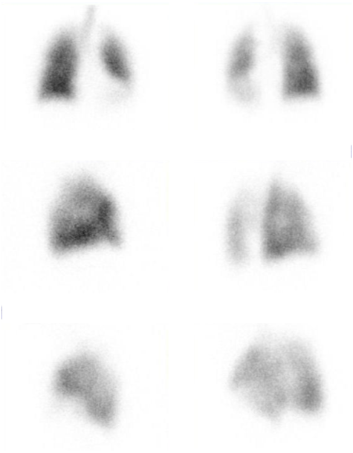
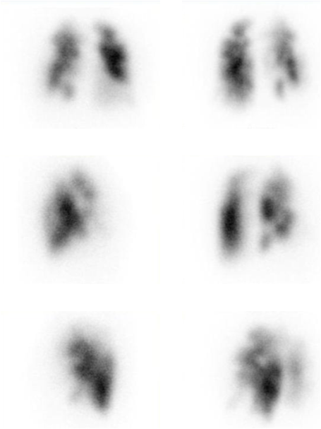
Lung scan after completion of AC therapy : what for?
PE
on CTPA
3Mo
V/Q scan
1y
?PE recurrence
RPVO or new PE??
High diagnostic value of a baseline V/Q scan after completion of 3-6 Mo of AC in case of suspicion of PE recurrence.

Slide 8
Lung scan and PE
T0
3-6 Mo
Diagnosis
of acute PE
Initial
management
Follow up
Anticoagulation
V/Q scan
V/Q scan
Baseline scan in case of suspicion of PE recurrence
RPVO : risk factor for PE recurrence

Slide 9
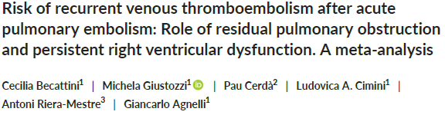
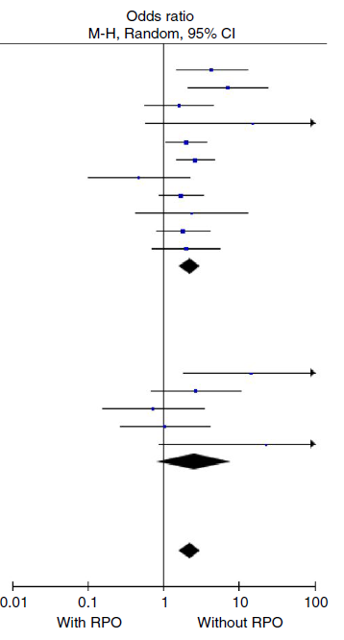
RPVO : risk factor for VTE recurrence
V/Q scan
V/Q scan :
11 studies; 2916 patients; OR 2.21; 95% CI 1.63‐3.01
RPVO associated with an increased risk of recurrent VTE
CTPA
CTPA :
5 studies; 556 patients; OR 2.56; 95% CI 0.82‐7.94.
No statistically significant association

Slide 10
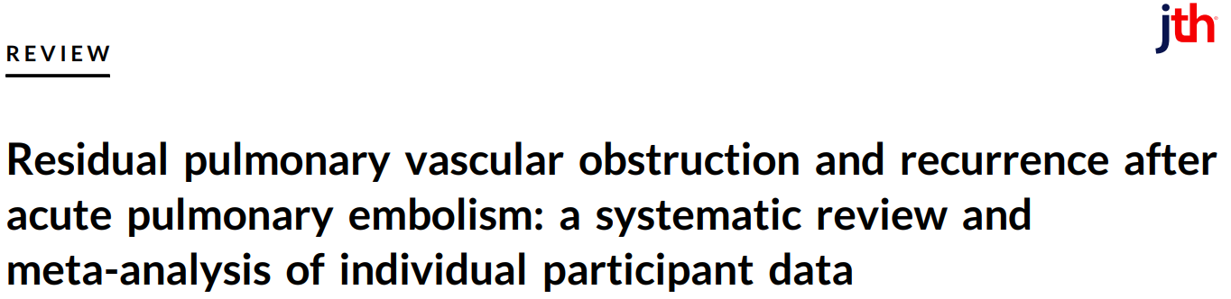

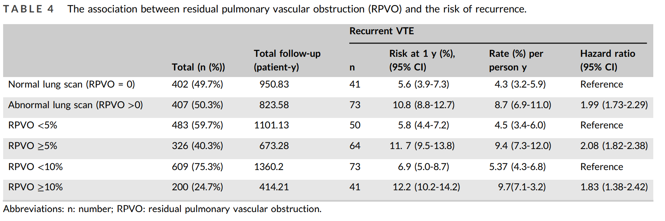
RPVO : risk factor for VTE recurrence
809 patients with individual participant data
Robin P, J Thromb Haemost 2023

Slide 11
RPVO : risk factor for VTE recurrence
Optimal threshold of RPVO= 3.2%
≈ 5 %
(≈ 1 segment or 2 sous-segments)
Receiver operating characteristic curve analysis of RPVO for recurrent VTE
Robin P, J Thromb Haemost 2023

Slide 12
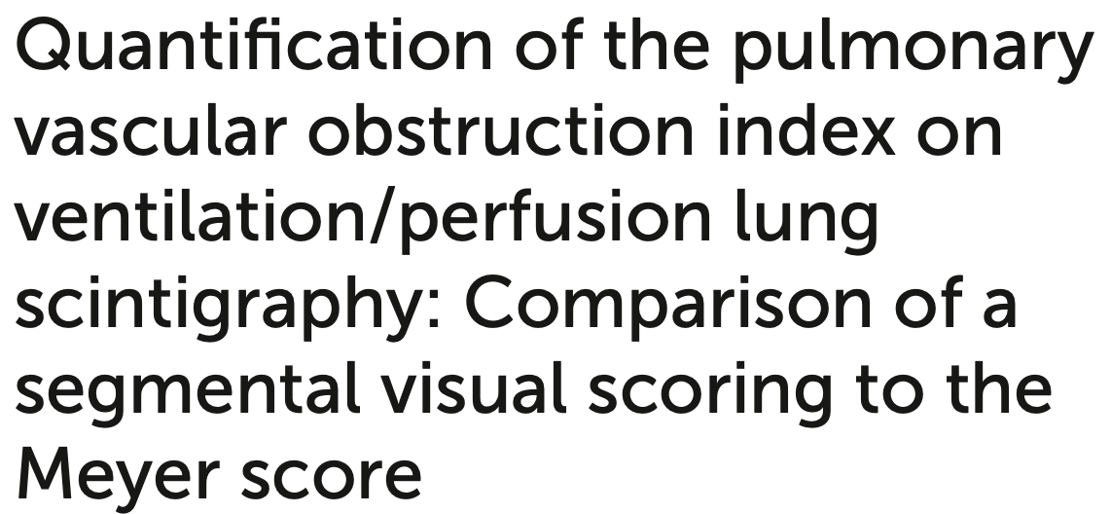
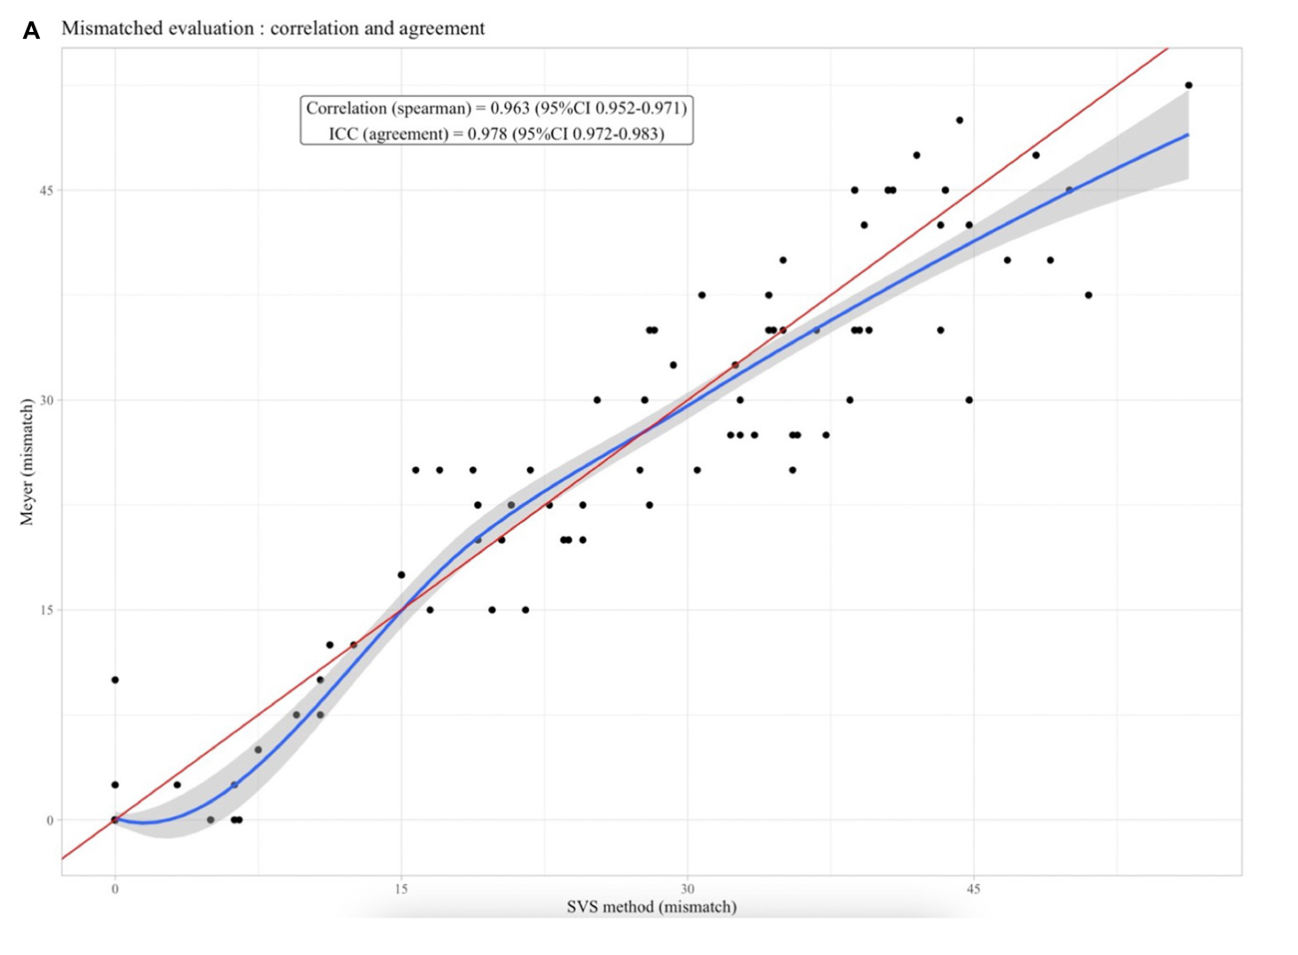
RPVO : quantification?
Visual score :
20 segments
2 sub-segments = 1 segment
1 segment = 5%
RPVO = Number of segments x 5%
Le Pennec R, Front Med 2022

Slide 13
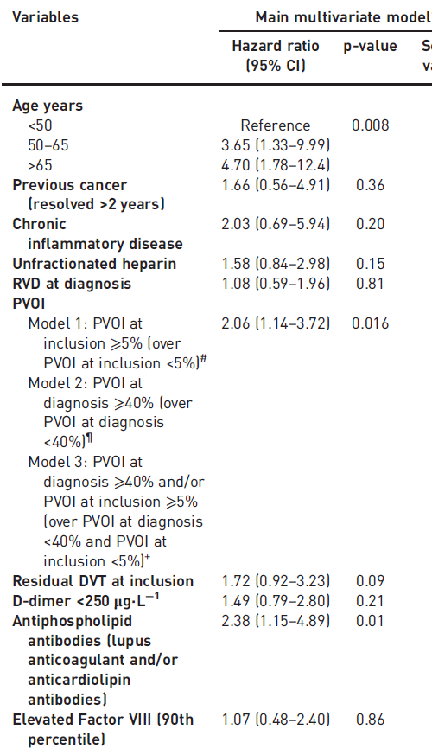

RPVO : risk factor for VTE recurrence
Risk factors of recurrent venous thromboembolism after a first episode of unprovoked pulmonary embolism.
Results from the PADIS-PE randomized clinical trial.
Tromeur C. Eur Resp Journ 2017
371 patients with a first unprovoked PE
V/Q scan after 6 months of AC
Median FU: 41 Mo, 67 recurrent VTE
Conclusion: In patients with first unprovoked PE, age of 50 years or older, pulmonary vascular obstruction index > 40% at the diagnosis of PE or > 5% after 6 months of anticoagulation, and APLA were associated with an significant increased risk of recurrent VTE.

Slide 14
RPVO : risk factor for VTE recurrence
Duration of AC after a first episode of PE : 3-6 Mo vs unlimited
decision should be individually tailored according to the risk of recurrent VTE, and balanced against the risk of bleeding.
predictors of recurrence could drive strategies for secondary prevention
RPVO after completion of 3-6 months anticoagulation :
predictor of VTE recurrence
2 fold increased risk of recurrence
Role in the decision to continue or discontinue anticoagulation?

Slide 15
Lung scan and PE
T0
3-6 Mo
Diagnosis
of acute PE
Initial
management
Follow up
Anticoagulation
V/Q scan
V/Q scan
Baseline scan in case of suspicion of PE recurrence
RPVO : Risk factor for VTE recurrence
Functional evaluation?

Slide 16
RPVO and functional evolution
After a first episode of PE:
Post-pulmonary embolism syndrome : 50% of PE survivors.
New or progressive dyspnea, exercise intolerance, and/or impaired functional or mental status after at least 3months of adequate anticoagulation following acute PE.
RPVO on V/Q scintigraphy : 30-50% after 6 months of anticoagulation.
Klok FA, Eur Hear J 2022

Slide 17
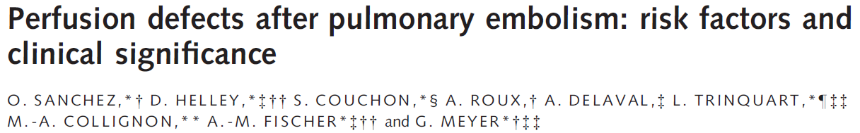
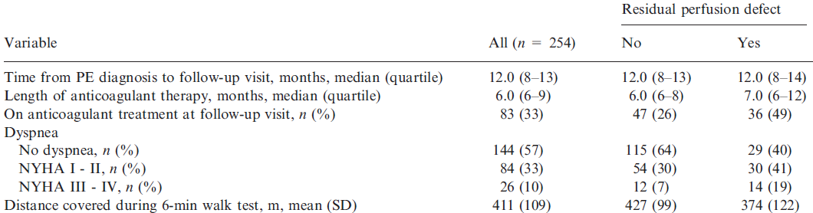
RPVO and functional evolution
Prospective observational cohort study of 254 patients with PE
Functional evaluation at 12Mo: Dyspnea, V/Q scan, Echocardiography, 6MWT
43% of patients presented with dyspnea
Higher incidence and severity of dyspnea in patients with RPVO

Slide 18
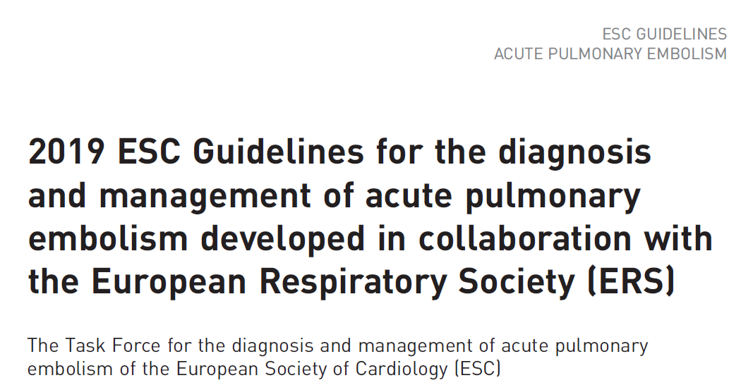
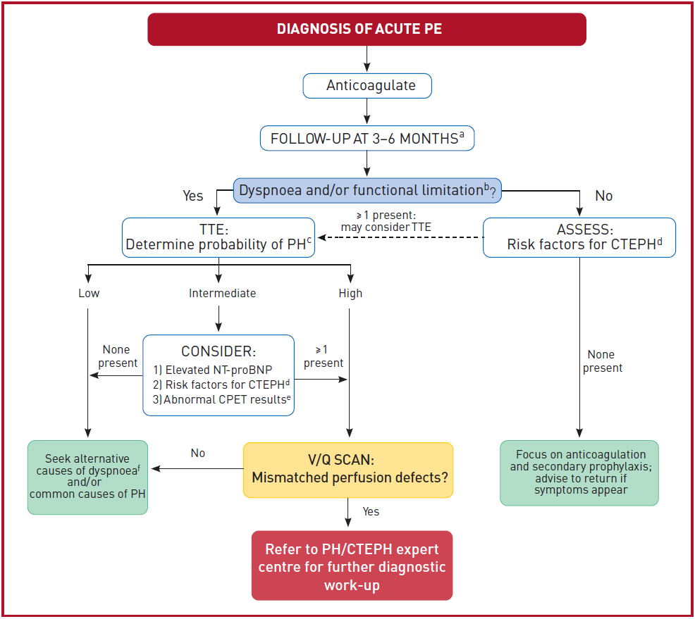
Chronic thromboembolic pulmonary hypertension
CTEPH
mPAP ≥ 25 mmHg / RPVO
5-years survival : 30% in patients with mPAP > 40 mmHg
Potentially curable (surgery, balloon pulmonary angioplasty, medical therapy).

Slide 19
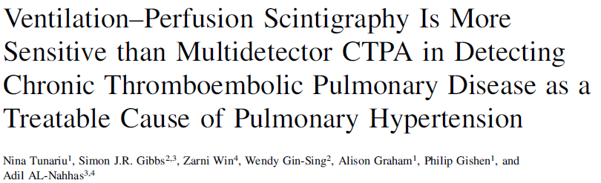
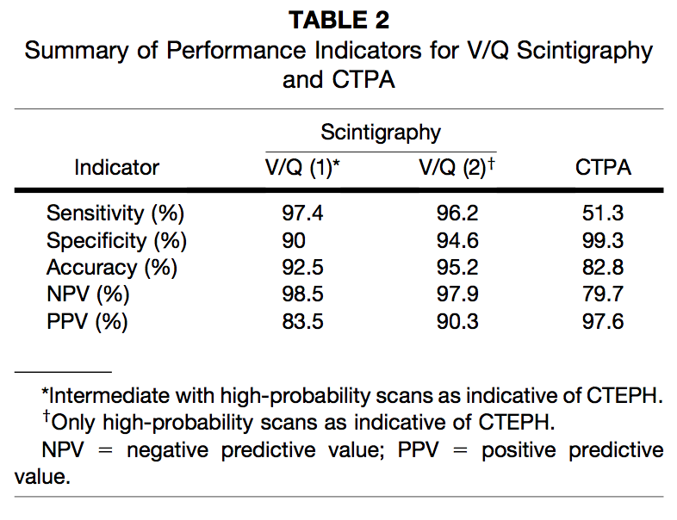
Chronic thromboembolic pulmonary hypertension
227 patients with PH
Final diagnosis (CTEPH vs. non-CTEPH) in accordance with
the guidelines of the European Society of Cardiology and the
American College of Chest Physicians

Slide 20
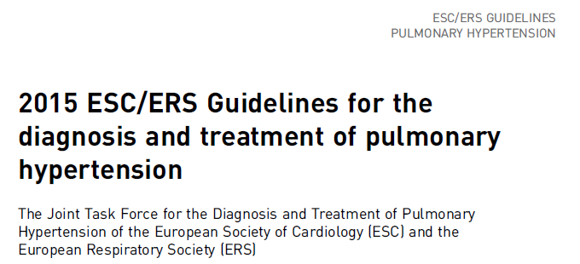
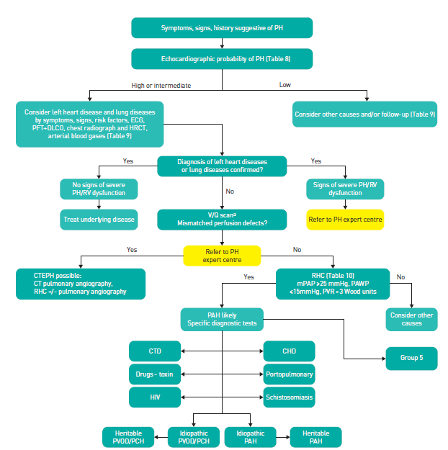
Chronic thromboembolic pulmonary hypertension
V/Q scan : imaging modality of choice to exclude CTEPH

Slide 21
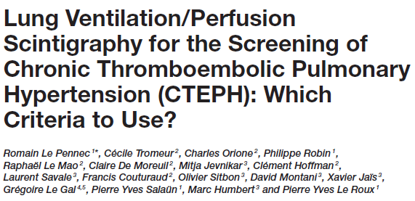
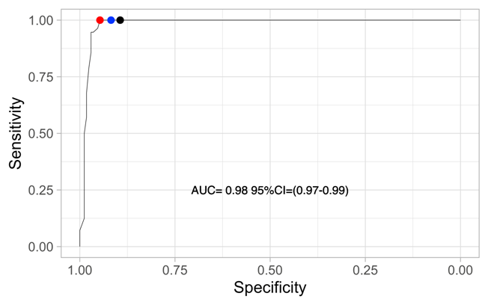

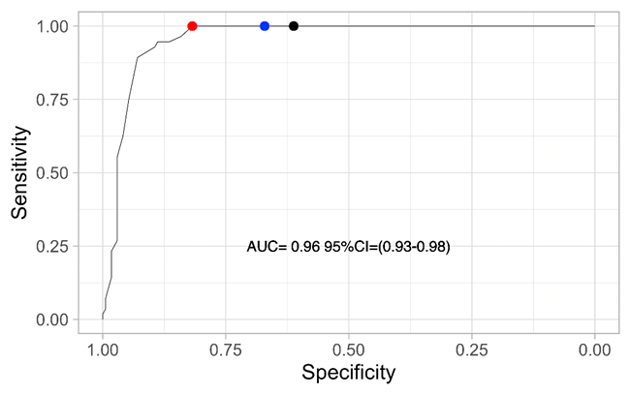
Chronic thromboembolic pulmonary hypertension
Mismatched perfusion defects
Front Med 2022
226 patients with PH (56 CTEPH)
Blinded retrospective central review
Perfusion defects
Optimal diagnostic cut-off : 2.5 segmental
mismatched defects
Need for ventilation scan as an interpretation only based on perfusion defects provided lower specificity.

Slide 22
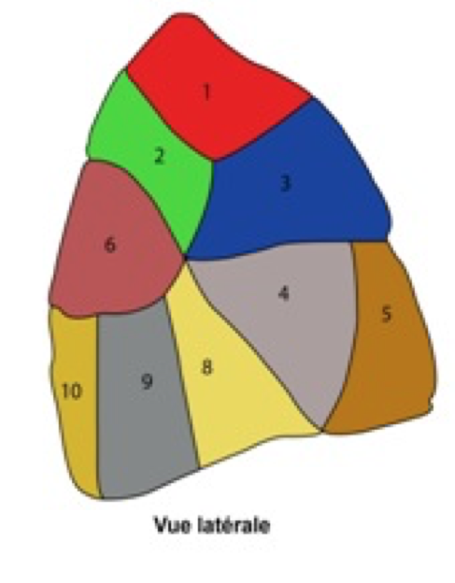
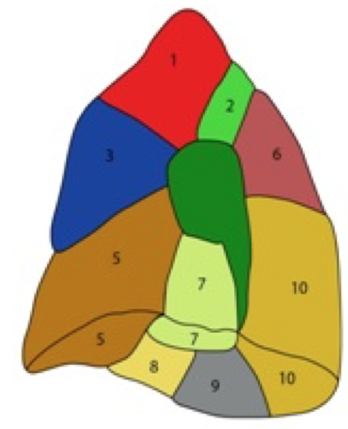
Chronic thromboembolic pulmonary hypertension
Nb of segmental mismatched defects
0
1
2
2,5
3
4
5
6
6,4
7
8
ESC/ERS
EANM
95 % of patients with CTEPH
Pioped
nég/pos
Optimal cut-off
Le Pennec R, Front Med 2022

Slide 23
Chronic thromboembolic pulmonary disease
50% of patients
30-50% RPVO on V/Q scan
1-4% of patients
Konstantinides SV, Eur Respir J 2019

Slide 24
Chronic thromboembolic pulmonary disease
« Chronic thromboembolic pulmonary disease » (CTEPD)
Dyspnea/functional limitation after at least 3 Mo of AC
RPVO on lung imaging
No evidence of pulmonary hypertension (mPAM<25) at rest
No other conditions that may contribute to symptoms
Prevalence of CTEPD likely higher than that of CTEPH
Management? AC?
Delcroix M, Eur Respir J 2021

Slide 25
Chronic thromboembolic pulmonary disease
419 Nuc Med departments surveyed in Australia, Canada, France, Germany and US in 2022-2023
Follow up of PE : SPECT used in 90,0% of centres
Screening of CTEPH : SPECT used in 85,7%
Le Pennec R. Clin Nucl Med 2024

Slide 26


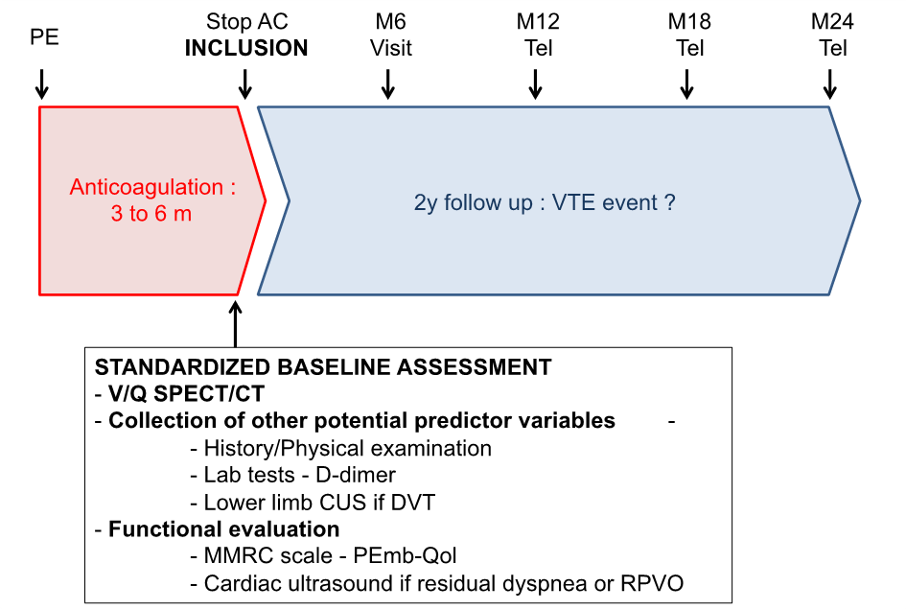
PRONOSPECT study
Multicenter prospective cohort study
Patients : 665
Centres : 13
Role of a V/Q SPECT/CT scan after 3/6 Mo of AC
Prediction of PE recurrence
Diagnosis of PE recurrence
Functional evaluation

Slide 27
Conclusion
T0
3-6 Mo
Diagnosis
of acute PE
Initial
management
Follow up
Anticoagulation
V/Q scan
Baseline scan in case of suspicion of PE recurrence
RPVO : Risk factor for VTE recurrence
Functional evaluation in symptomatic patients:
CTEPH screening / CTEPD

