Slide 1
Choline PET-CT versus classic parathyroid nuclear imaging techniques
Bracke Amelientje

Slide 2
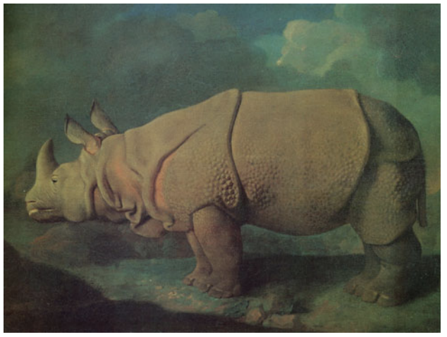
Notes:
This is a picture of a indian rhino also know an rhinoceros unicornis.
In 1834 a male indian rhino was bought by Richard Owen who was an anatomist at the Londan Zoological Society.
He became the most popular exhibit in the zoo an was was housed with the elephants in the Elephant House.
Sadly after 15 year of a peacefull life he started to being bullied bij a large male elephant and died shortly after due to traumatic injuries.
Richard Owen who wad now an anatomy profressor preformed the autopsy and did a disection that would take several months to complete.
During this disection he saw ‘a small compact yellow glandular body was attached to the thyroid at the point where the veins emerge’.
And this lead to the first discovery of a parathyroid.
In 1834, the London Zoological Society purchased a male Indian Rhinoceros, Rhinoceros unicornis, at the request of the anatomist, Richard Owen. Fifteen years later, the rhinoceros died from traumatic injuries, and the necropsy performed by Owen led to the very first discovery of parathyroid glands. Around this time, Richard Owen and Charles Darwin vehemently disagreed with one another about the theory of natural selection. Their public feud sparked the public’s interest in Darwin and his theory while Owen became less popular despite his many accomplishments in the scientific world. Not until decades after Owen’s death was his contribution to the identification of parathyroid glands discovered. Because his discovery is considered pivotal to the history of endocrine surgery, we sought to investigate the circumstances surrounding the rhinoceros’ death, its dissection, and Owen’s initial discovery.
Bron: foto Stubbs painting of a rhinoceros from The Rhinoceros from Durer to Stubbs 115–1799, Vol. 1, London, Philip Wilson Publishers LTD; 1986

Slide 3
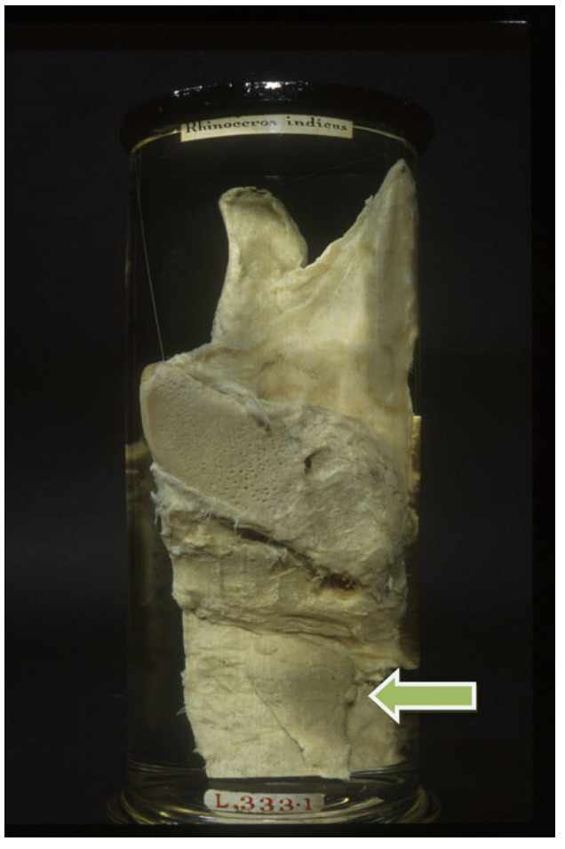
Notes:
Bron: The Death of an Indian Rhinoceros . Felger and Zeiger Societe Internationale de Chirurgie 2010
In 1834, the London Zoological Society purchased a male Indian Rhinoceros, Rhinoceros unicornis, at the request of the anatomist, Richard Owen. Fifteen years later (1849), the rhinoceros died from traumatic injuries, and the necropsy performed by Owen led to the very first discovery of parathyroid glands. Around this time, Richard Owen and Charles Darwin vehemently disagreed with one another about the theory of natural selection. Their public feud sparked the public’s interest in Darwin and his theory while Owen became less popular despite his many accomplishments in the scientific world. Not until decades after Owen’s death was his contribution to the identification of parathyroid glands discovered. Because his discovery is considered pivotal to the history of endocrine surgery, we sought to investigate the circumstances surrounding the rhinoceros’ death, its dissection, and Owen’s initial discovery.
Bron: foto Stubbs painting of a rhinoceros from The Rhinoceros from Durer to Stubbs 115–1799, Vol. 1, London, Philip Wilson Publishers LTD; 1986
Desectiestu: Owen’s dissection of the parathyroid gland (arrow) of the Indian rhinoceros. Reproduced with permission from the Royal College of Surgeons of England

Slide 4
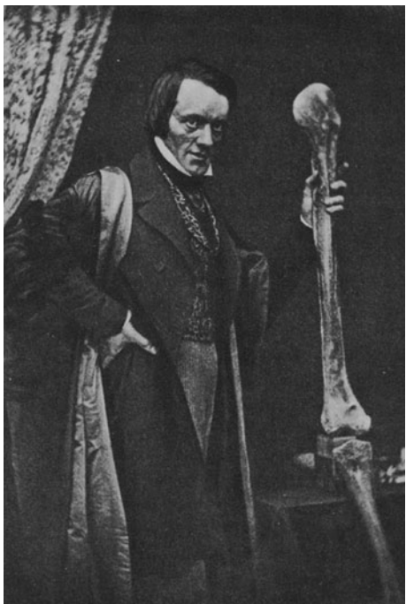
Notes:
Sadly is was only deceades after his death that Richard owen receaved credit for his discovery.
But that was his own foult
Richard owen was the mentor of Charles Darwin but could nog let go of his ceastionist ideas an publicly oposes darwin’s evolution theory. And that’s why he eventualy was dismissed and forgotten by the scientific community.
Bron: The Death of an Indian Rhinoceros . Felger and Zeiger Societe Internationale de Chirurgie 2010
In 1834, the London Zoological Society purchased a male Indian Rhinoceros, Rhinoceros unicornis, at the request of the anatomist, Richard Owen. Fifteen years later (1849), the rhinoceros died from traumatic injuries, and the necropsy performed by Owen led to the very first discovery of parathyroid glands. Around this time, Richard Owen and Charles Darwin vehemently disagreed with one another about the theory of natural selection. Their public feud sparked the public’s interest in Darwin and his theory while Owen became less popular despite his many accomplishments in the scientific world. Not until decades after Owen’s death was his contribution to the identification of parathyroid glands discovered. Because his discovery is considered pivotal to the history of endocrine surgery, we sought to investigate the circumstances surrounding the rhinoceros’ death, its dissection, and Owen’s initial discovery.
Bron: foto Stubbs painting of a rhinoceros from The Rhinoceros from Durer to Stubbs 115–1799, Vol. 1, London, Philip Wilson Publishers LTD; 1986
Desectiestu: Owen’s dissection of the parathyroid gland (arrow) of the Indian rhinoceros. Reproduced with permission from the Royal College of Surgeons of England

Slide 5
Anatomy - Embryology - Localization

Slide 6
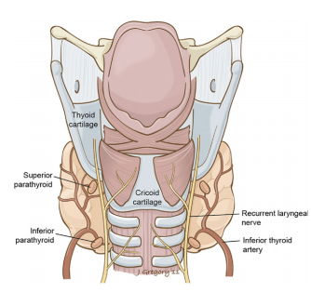
Anatomy
Average of 4 glands posterior of the thyroid gland (can range from 3 to 8)
Average 6mm length and 3-4mm width and 35-55mg. Disc-shaped.
Superior glands:
Close connection with thyroid gland
Mainly posterior to the thyroid upper poles at the level of the lower edge of the cricoid cartilage
Inferior glands:
More variable location (thymus)
50% lateral to the thyroid lower poles
15% >1cm distal to the lower poles (ectopic) (anywhere between mandibular angle and upper mediastinum)
Only 2% of parathyroids lie inside the thyroid
© Anatomy and embryology of the thyroid and parathyroid glands. Semin Ultrasound CT MR. 2012
Notes:
Normaly we have 4 parathyroid glands who are located posteriorly of the thyroid gland.
2 superior parathyroids and 2 inferior parathyroids
rarely the parathyroids lie inside of the thyroid tissue

Slide 7
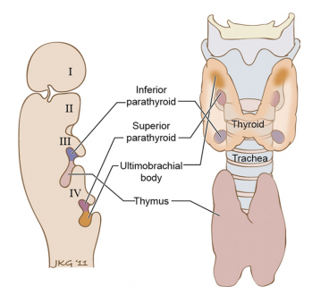
embryology
© Anatomy and embryology of the thyroid and parathyroid glands. Semin Ultrasound CT MR. 2012
Notes:
Inferior parathyroid develop in the same branchial pouch as the thymus and that is why the localisation is more variable
The upper parathyroids develop together with the C cels of the thyroid.
Inferior glands originate from the 3rd brachial pouch along with the thymus
Superior glands originate from the 4th brachial pouch along with the ultimobrachial body - C-cells thyroid.

Slide 8
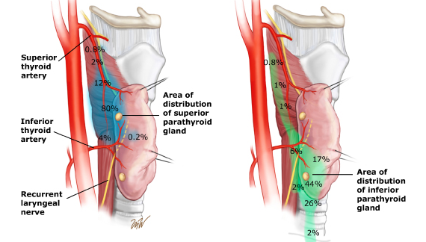
Variable localization
©2017 UpToDate®
Notes:
Embryological origin explains the variable location.
Inferior parathyroids may be localized above the superior parathyroids.
Superior glands mostly posteriorly and inferior glands anteriorly to the tracheoesophageal groove/ recurrent laryngeal nerve.

Slide 9
Histology and normal function of parathyroids

Slide 10
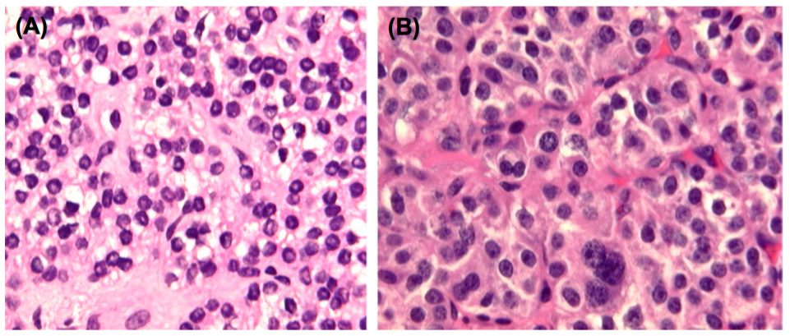
Histology
Functional cells
© The parathyroids: basic and clinical concepts. Third edition: Elsevier/AP; 2015.
Chief cells
Produce PTH
(B) Oxyphilic cells
Not endocrine active, function unclear
Abundant in mitochondria (Tc-Sestamibi uptake)
Rare before puberty and appear increasingly in young adults
Notes:
Chief cells: Round, small round dark centrally located nuclei
'Clear cells' are a type of chief cells vacuolized with lipids and glycogen.
Oxyphilic cells: Larger than chief cells with abundant eosinophilic cytoplasm.
Rare before puberty and appear increasingly in young adults
Transitional cells are a likely transitional form of chief cells to oxyphilic cells
Adipocytes:
Arise in puberty and increase with age.
Chief cells:
Produce PTH.
May differ in appearance depending on resting, synthesizing or secreting state
Small round dark centrally located nuclei
In normocalcemia 80% at rest
'Clear cells' are a type of chief cells vacuolated with lipids and glycogen.
Oxyphilic cells:
Not endocrine active, function unclear
Larger than chief cells with abundant eosinophilic cytoplasm and mitochondria (Tc-Sestamibi uptake)
Rare before puberty and appear increasingly in young adults
Transitional cells are a likely transitional form of chief cells to oxyphilic cells

Slide 11
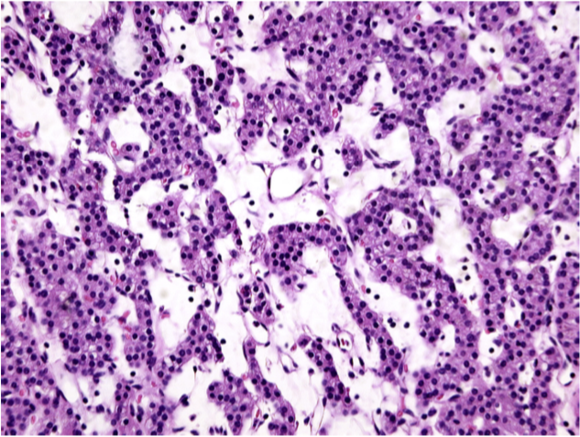
Histology
Normal parathyroid tissue
© The parathyroids: basic and clinical concepts. Third edition: Elsevier/AP; 2015.
Notes:
The functional cells (mainly dark and small chief cells) organized in groups and strands and fed by a capillary network.
The bright areas are adipocytes

Slide 12
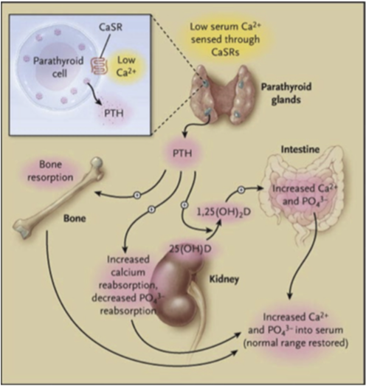
Function
Calcium homeostasis
Parathyroid cells can already detect a 1-2% variation in serum calcium and adjust PTH secretion
Hypocalcemia ➔ increase PTH secretion
Hypercalcemia ➔ decrease PTH secretion (calcitonin  from thyroid)
PTH affects:
The kidney: phosphate excretion, calcium reabsorption and vitamin D production
Intestinal: indirectly through increased vitamin D production which in turn stimulates calcium and phosphate absorption
The bone: together with vitamin D, stimulates the release of calcium (and phosphate) from the bone
© The parathyroids: basic and clinical concepts. Third edition: Elsevier/AP; 2015.
Notes:
Fuction calcium: bone formation, muscle contraction, signal transduction, potential difference cell membranes
Calcitonin is released from C cells of the thyroid to promote calcium absorption into the bone
Hormonally active vitamin D 1,25 dihydroxyvitamin D
Normal balanced calium concentration in our blood.

Slide 13
Hyperparathyroidism

Slide 14
hyperparathyroidism
Primary hyperparathyroidism:
Hypercalcemia and elevated (or still normal) PTH due to inadequately increased PTH secretion by 1 or more parathyroids in the absence of a known stimulus for parathyroid volume increase.
Secondary hyperparathyroidism:
Decreased or normal serum calcium and increased PTH in response to hypocalcemia or hyperphosphatemia due to, e.g., renal dysfunction or vitamin D deficiency.
Tertiary hyperparathyroidism:
Persistent elevation of PTH levels after treatment of secondary hyperparathyroidism because of autonomous PTH production.
Notes:
Uit doktoraat: prim hyperpara: primary hyperparathyroidism was defined as either a persistent elevation of serum calcium levels with corresponding elevated or nonsuppressed PTH levels or high PTH levels and normal serum calcium levels (i.e., normocalcemic hyperparathyroidism)

Slide 15
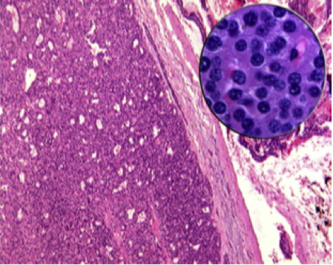
Primary hyperparathyroidism
Mainly caused by a parathyroid adenoma (80%), rarely 2 adenomas (+- 5%)
F/M 3:1
Predominantly. inferior parathyroids
10% ectopic
1-3 cm in size
150 mg - several grams
Monoclonal proliferation: Most common consists of mainly chief cells (>90%)
Disappearing adipocytes
50-60% presence of an edge of normal parathyroid tissue (capsule)
In about 15% caused by parathyroid hyperplasia:
Diffuse or multifocal expansion of the parenchymal mass: most common chief cell hyperplasia (rare clear cell hyperplasia)
30% underlying MEN1 or familial hyperparathyroidism (5% total pHPT diagnosis)
< 1% caused by parathyroid carcinoma
© The parathyroids: basic and clinical concepts. Third edition: Elsevier/AP; 2015.
Notes:
In primary hyperparathyroidism, when hyperplasia occurs, the parathyroids are asymmetrically affected and 1 or 2 glands may be normal in size but show microscopic signs of hyperplasia.
Chief cell hyperplasia is most common and shows a mixture of chief cells and to a lesser extent oxyphilic cells. The cells lie in a diffuse pattern or in nodules
MEN1: hyperparathyroidism, pituitary tumors, neuroendocrine tumors of the pancreas
MEN2a: hyperparathyroidism, medullary thyroid carcinoma, pheochomocytoma
Familial hyperparathyroidism affects only the parathyroids

Slide 16
Indications for surgery and pre-surgery localization

Slide 17
Indications for surgery
Symptomatic disease
Asymptomatic disease
Significantly elevated calcium (>1mg/dl or > 0.25 mmol/l above the upper limit of normal)
Decreased renal function
Kidney stones
Osteoporosis
Vertebral compression fracture
Younger than 50y
Notes:
When the patiënt meets one of these criteria. Mainly asymtomatic problems caused by the hypercalcemia or increased PTH production.
Guidelines 2014 J Clin endocrinological metabolism
Symptoms: polyuria, abdominal cramps, vomiting, nausea, depressive symptoms, bone pain, (Stones, bones, groans, thrones (polyuria) and psychiatric overtones)
Significantly elevated calcium (>1mg/dl or > 0.25 mmol/l above the upper limit of normal)
Decreased renal function: clearance < 60 ml/min
Nephrolithiasis: on x ray ultrasound or CT
Osteoporosis: T-score of less than -2.5 lumbar, global hip, femoral neck and 1/3 distal radius
Indentation fracture: on x ray VFA

Slide 18
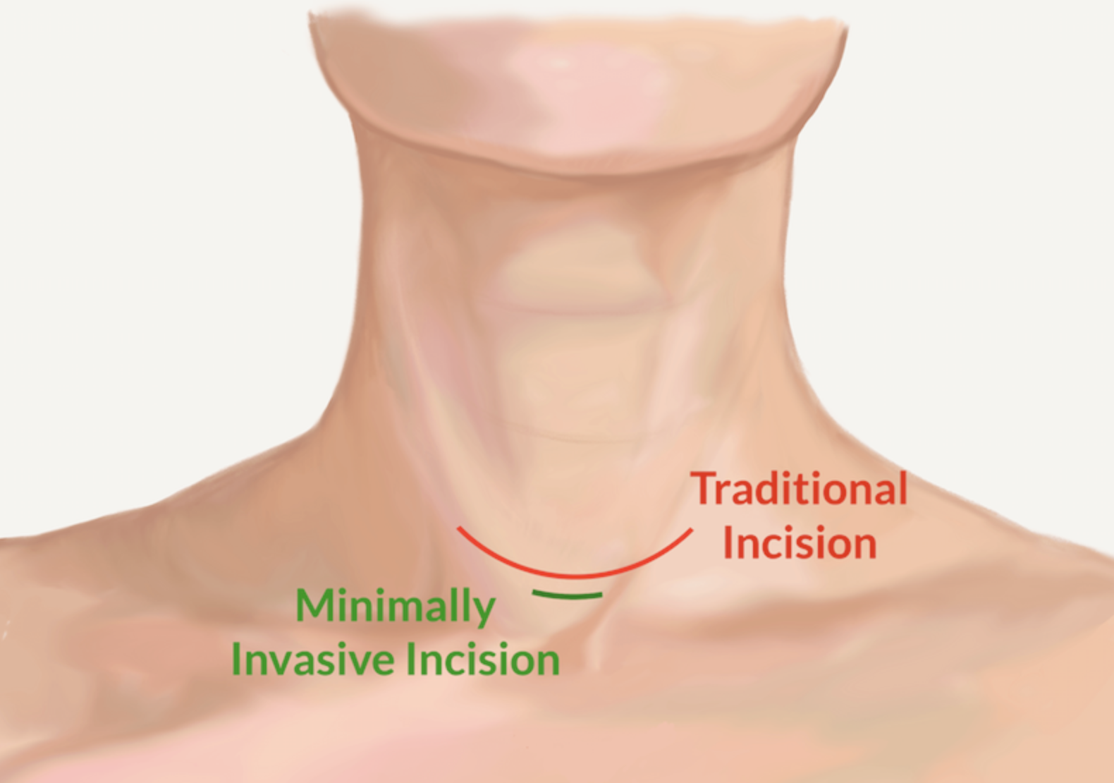
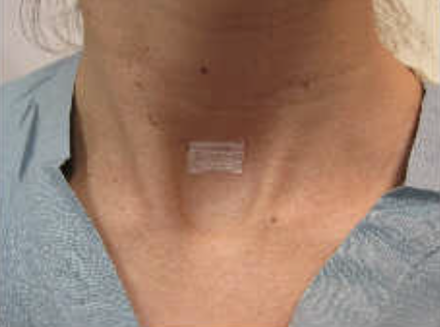
Indications for surgery
Precise localization -> minimal invasive surgery
Image-guided minimally invasive parathyroidectomy:
similar efficacy
less discomfort due to a shorter excision
shorter operation time
fewer complications
faster recovery
overall less expense for the patient
Notes:
3. Taieb D, Hindie E, Grassetto G, Colletti PM, Rubello D. Parathyroid scintigraphy: when, how, and why? A concise systematic review. Clin Nucl Med. 2012;37:568–74. https://doi.org/10. 1097/RLU.0b013e318251e408. 4. Wilhelm SM, Wang TS, Ruan DT, Lee JA, Asa SL, Duh QY, et al. The American association of endocrine surgeons guidelines for definitive management of primary hyperparathyroidism. JAMA Surg. 2016;151:959–68. https://doi.org/10.1001/jamasurg.2016. 2310.
Prentje hals: center for advanced parathyroid surgery
Foto: parathyroid.com
If surgery is indicated, preoperative localization of the hyperfunctioning gland(s) allows for selective parathyroidectomy, reducing operation time, complications and hospitalization, improving postoperative recovery, and resulting in a better cosmetic outcome, and greater patient satisfaction

Slide 19
Pre-surgery localization

Slide 20
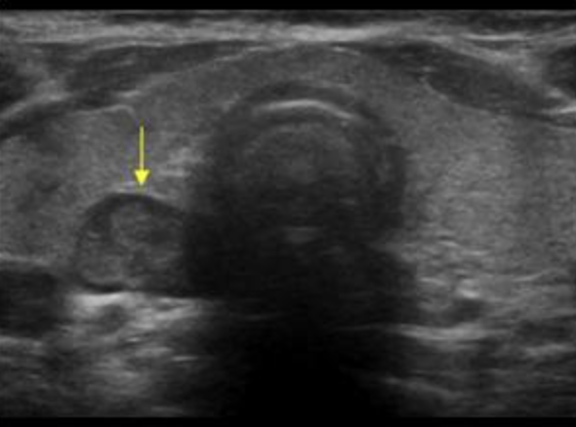
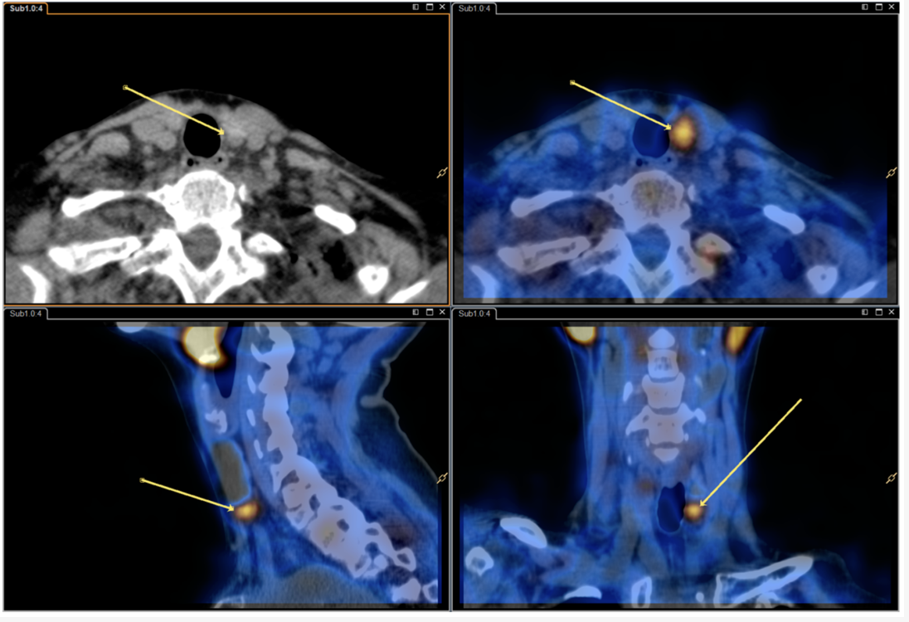
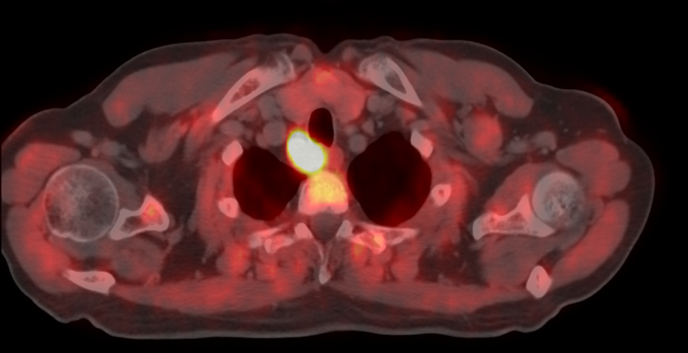
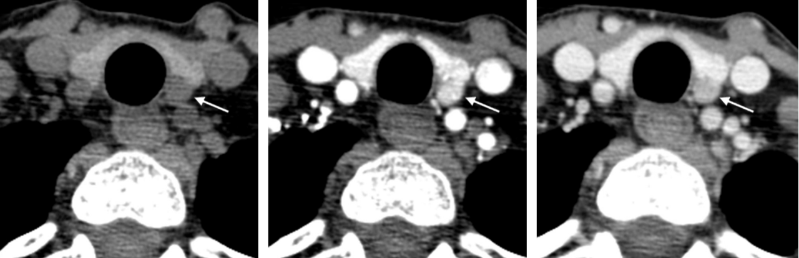
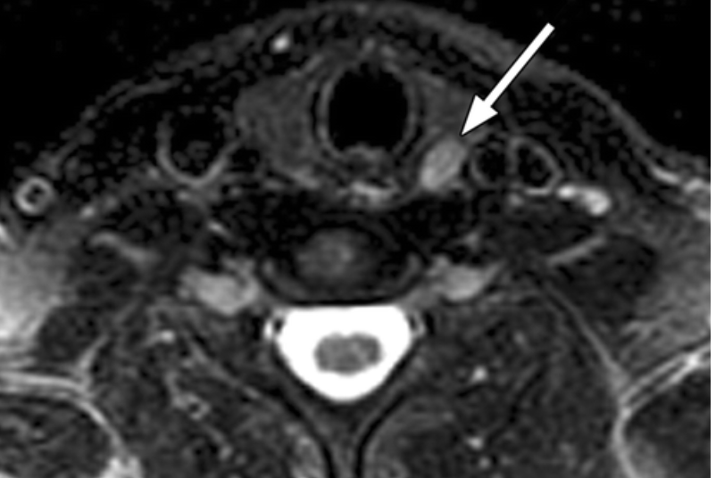
pre-surgery localization
Ultrasound
Scintigraphy
Fluorocholine PET/CT
4DCT
MRI

Slide 21
Parathyroid scintigraphy

Slide 22
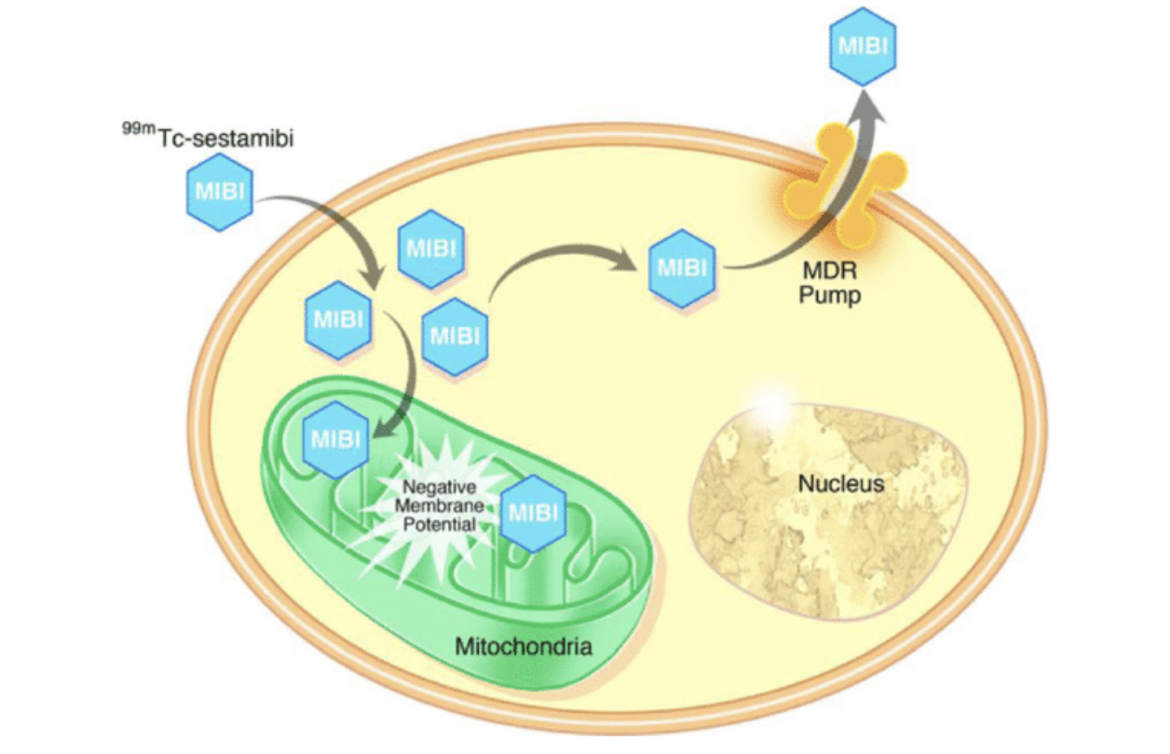
Parathyroid scintigraphy
SestaMIBI or Tetrofosmin.
Accumulates in hyperfunctioning parathyroid glands due to their increased number of mitochondria (mainly related to the number of oxyphilic cells).
© Correlation of 99mTc-sestamibi uptake in renal masses with mitochondrial content and multi-drug resistance pump expression. Rowe et al. Oct 2017
Notes:
We can use sestamibi or tetrofosmin
It’s based on its uptake in the mitocondria of oxyphilic cells
1989 introduction SestaMIBI for parathyroid localization (better imaging characteristics than previously used Thallous-chloride).
The 1990s: More widespread use of SestaMIBI and Tetrofosmin.
a lipophilic cationic complex that diffuses passively through the cell membrane and accumulates in hyperfunctioning parathyroid glands due to their increased number of mitochondria. which is mainly related to the number of oxyphilic cells.
Its uptake and retention depend also on the cell cycle phase, parathyroid blood supply, capillary permeability, serum calcium level, expression of P-glycoprotein, and multidrug resistance (MDR) associated protein.
Washes out faster from the thyroid than from the hyperfunctioning parathyroid, making it convenient for the single-tracer dual-phase method (CAVE only for sestaMIBI, Tetrofosmin kinetics make is less useful for washout studies, only dualtracer substraction method).
SestaMIBI SPECT/CT scintigraphy is the current standard method for detecting hyperfunctioning parathyroid glands, with a reported patient-based and lesion-based pooled detection rate (DR) of 88% in a meta-analysis of twenty-three papers including 1236 patients with pHPT (Treglia G et al. Head Neck. 2016). 61% for multiglandular disease, vs. 97% for single-gland disease (Nichols et al. Nucl Med Commun. 2012)
Bron prentje: Correlation of 99mTc-sestamibi uptake in renal masses with mitochondrial content and multi-drug resistance pump expression. Rowe et al. Oct 2017
BRON: EANM practice guidelines
Bron waarom tetro minder nuttig is voor wash out: Apostolopoulos DJ, Houstoulaki E, Giannakenas C, Alexandrides T, Spiliotis J, Nikiforidis G, et al. Technetium-99m-tetrofosmin for parathyroid scintigraphy: comparison to thalliumtechnetium scanning. J Nucl Med. 1998;39(8 SUPPL):1433–41.

Slide 23
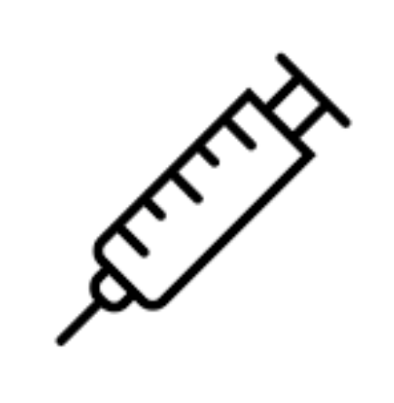
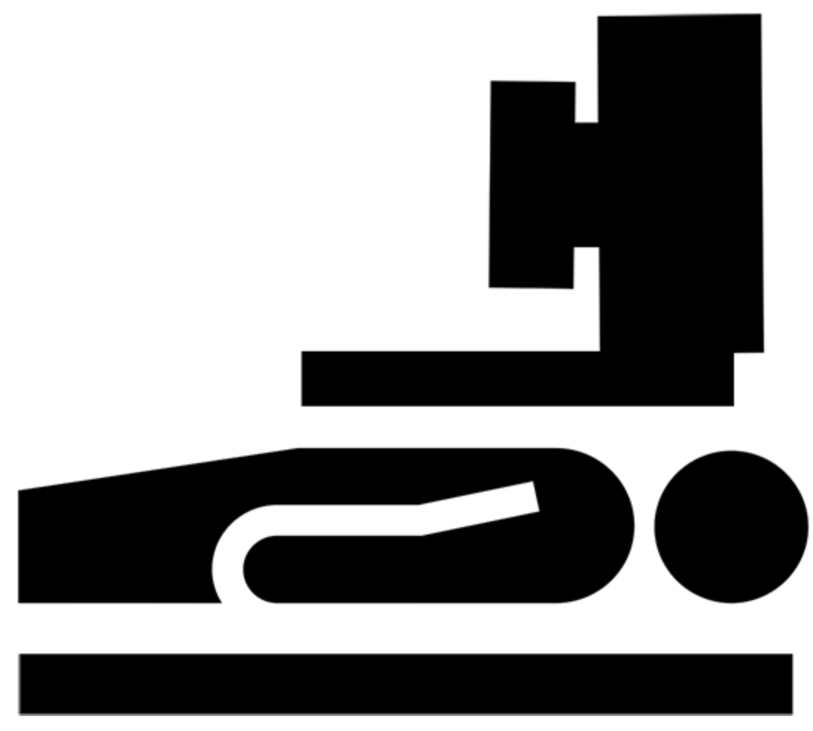
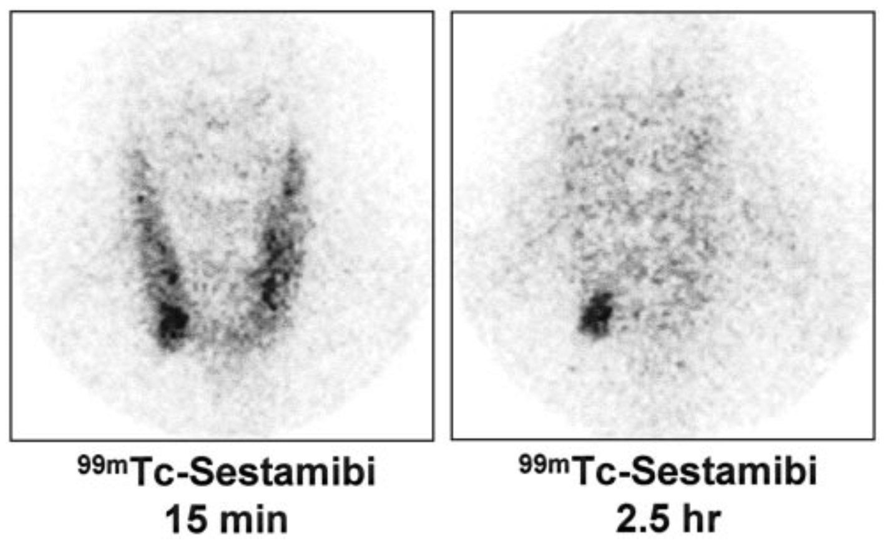
Parathyroid scintigraphy
Dual phase (wash out) scintigraphy
10 min
1,5-2 h
Only SestaMIBI
© Preoperative Localization and Radioguided Parathyroid Surgery. Mariani et al. Oct 2003
Notes:
You can use the product in different ways
A Dual phase or wash out scintigraphy uses the fact that there is a SestaMIBI uptake in de thyroid and parathyroId but that there is a faster wash out of the product out of the thyroid tissue and a retention in de parathyroid tissue.
interesting to know is that teteroformin is les suitable for wash out because the wash out from the thyroid and parathyroid are to simular.
You can add a SPECT/CT at the end of this protocol to get a precise location of the parathyroid tissue.
I would only recommend this scanning technique if your patiënt had recently underwent a contract enhanced CT scan and can not have substraction scintigraphy because the thyroid is filled with iodine and the investigation is urgent.
You can also do substraction immaging. Here u use 2 tracers, one tracer who has an uptake in the thyroid and parathyroid tissue (sestamibi or tetrofosmin) and one tracer who only visualises the thyroid (iodine 123 or technetium). And if you substract the 2 immages the parathyroid shoud appear. If you do the substraction with iodine 123 instead of technetium you can do one SPECT/CT of the neck and simultaniously detect the two isotopes becouse of their different energy levels (140keV for technetium en 159 keV for iodine). An advantage because there cant be any movement artefacts.
Dual phase (wash out)
10–15 min and 90–150 min after intravenous administration of the radiopharmaceutical.
SPECT/CT with [99mTc]Tc-MIBI is superior to planar or stand-alone SPECT studies and dual-phase acquisition is more accurate than single-phase acquisition.
Dual-tracer parathyroid scan
[99mTc]Tc-MIBI or Na[99mTc]TcO4
Na[99mTc]TcO4 images are obtained 20–30 min after administration of the radiopharmaceutical, while [99mTc]TcMIBI images are obtained 10–15 min after injection
Na[99mTc]TcO4 images are either digitally or cognitively subtracted from the [ 99mTc]Tc-MIBI images
[99mTc]Tc-MIBI / Na[ 123I]I protocol
Na[123I]I is first administered orally or intravenously, and [99mTc]Tc-MIBI is injected 2 h later. Na[123I]I and [99mTc]Tc-MIBI images are acquired simultaneously, starting 5 min after injection of [ 99mTc]Tc-MIBI. high sensitivity and specificity for subtraction SPECT/CT (95% and 89%, respectively) (Woods et al. Nucl Med Commun. 2017)
In both dual-tracer protocols images are subtracted at the point of similar activity of [^{99m}Tc]Tc-MIBI in the thyroid gland and surrounding soft tissue.
SestaMIBI SPECT/CT scintigraphy is the current standard method for detecting hyperfunctioning parathyroid glands, with a reported patient-based and lesion-based pooled detection rate (DR) of 88% in a meta-analysis of twenty-three papers including 1236 patients with pHPT (Treglia G et al. Head Neck. 2016). 61% for multiglandular disease, vs. 97% for single-gland disease (Nichols et al. Nucl Med Commun. 2012)

Slide 24
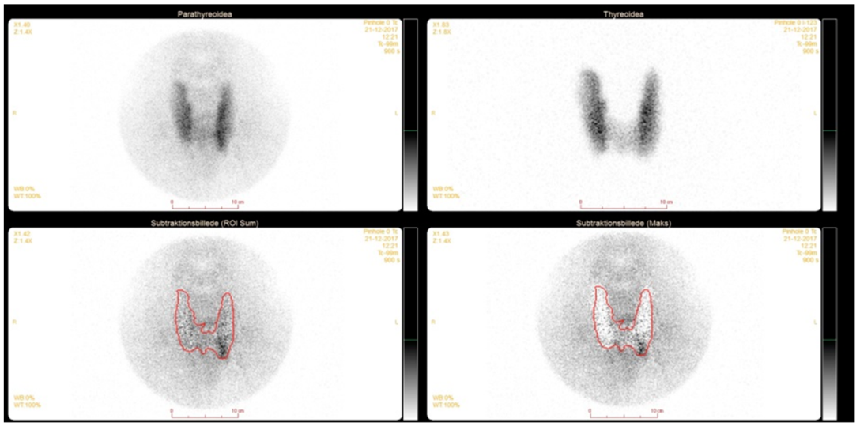
Parathyroid scintigraphy
Subtraction protocol
SestaMIBI
Tetroformin
99mTechnetium
I-123
Subtraction
SPECT/CT
© Added Value of Subtraction SPECT/CT in Dual-Isotope Parathyroid Scintigraphy. Christensen et al. Diagnostics 2020
Notes:
You can use the product in different ways
Because of the faster wash out of the thyroid gland you can do a dual phase of wash out protocol were you make an image 10 minutes after injection and 1.5 or 2 hours after injection. (interesting to know is that teteroformin is les suitable for wash out because of it’s les favourable wash out kinetics) the wash out from the thyroid and parathyroid are to simular).
You can also do substraction immaging. Here u use 2 tracers, one tracer who has an uptake in the thyroid and parathyroid tissue (sestamibi or tetrofosmin) and one tracer who only visualises the thyroid (iodine 123 or technetium). And if you substract the 2 immages the parathyroid shoud appear. If you do the substraction with iodine 123 instead of technetium you can do one SPECT/CT of the neck and simultaniously detect the two isotopes becouse of their different energy levels (140keV for technetium en 159 keV for iodine). An advantage because there cant be any movement artefacts.
Dual phase (wash out)
10–15 min and 90–150 min after intravenous administration of the radiopharmaceutical.
SPECT/CT with [99mTc]Tc-MIBI is superior to planar or stand-alone SPECT studies and dual-phase acquisition is more accurate than single-phase acquisition.
Dual-tracer parathyroid scan
[99mTc]Tc-MIBI or Na[99mTc]TcO4
Na[99mTc]TcO4 images are obtained 20–30 min after administration of the radiopharmaceutical, while [99mTc]TcMIBI images are obtained 10–15 min after injection
Na[99mTc]TcO4 images are either digitally or cognitively subtracted from the [ 99mTc]Tc-MIBI images
[99mTc]Tc-MIBI / Na[ 123I]I protocol
Na[123I]I is first administered orally or intravenously, and [99mTc]Tc-MIBI is injected 2 h later. Na[123I]I and [99mTc]Tc-MIBI images are acquired simultaneously, starting 5 min after injection of [ 99mTc]Tc-MIBI. high sensitivity and specificity for subtraction SPECT/CT (95% and 89%, respectively) (Woods et al. Nucl Med Commun. 2017)
In both dual-tracer protocols images are subtracted at the point of similar activity of [^{99m}Tc]Tc-MIBI in the thyroid gland and surrounding soft tissue.
SestaMIBI SPECT/CT scintigraphy is the current standard method for detecting hyperfunctioning parathyroid glands, with a reported patient-based and lesion-based pooled detection rate (DR) of 88% in a meta-analysis of twenty-three papers including 1236 patients with pHPT (Treglia G et al. Head Neck. 2016). 61% for multiglandular disease, vs. 97% for single-gland disease (Nichols et al. Nucl Med Commun. 2012)

Slide 25

Parathyroid scintigraphy
Subtraction protocol (Dual-tracer vs Dual isotope)
20 min
10 min
99mTc
MIBI
2 h
5 min
I-123
MIBI
140 keV
159 keV
No movement artefacts with I-123
Subtraction in combination with SPECT/CT most sensitive
SestaMIBI SPECT/CT is the current standard with a detection rate of 88% (meta-analysis of twenty-three papers including 1236 patients with pHPT).
Notes:
You can use the product in different ways
Because of the faster wash out of the thyroid gland you can do a dual phase of wash out protocol were you make an image 10 minutes after injection and 1.5 or 2 hours after injection. (interesting to know is that teteroformin is les suitable for wash out because of it’s les favourable wash out kinetics) the wash out from the thyroid and parathyroid are to simular).
You can also do substraction immaging. Here u use 2 tracers, one tracer who has an uptake in the thyroid and parathyroid tissue (sestamibi or tetrofosmin) and one tracer who only visualises the thyroid (iodine 123 or technetium). And if you substract the 2 immages the parathyroid shoud appear. If you do the substraction with iodine 123 instead of technetium you can do one SPECT/CT of the neck and simultaniously detect the two isotopes becouse of their different energy levels (140keV for technetium en 159 keV for iodine). An advantage because there cant be any movement artefacts.
Dual phase (wash out)
10–15 min and 90–150 min after intravenous administration of the radiopharmaceutical.
SPECT/CT with [99mTc]Tc-MIBI is superior to planar or stand-alone SPECT studies and dual-phase acquisition is more accurate than single-phase acquisition.
Dual-tracer parathyroid scan
[99mTc]Tc-MIBI or Na[99mTc]TcO4
Na[99mTc]TcO4 images are obtained 20–30 min after administration of the radiopharmaceutical, while [99mTc]TcMIBI images are obtained 10–15 min after injection
Na[99mTc]TcO4 images are either digitally or cognitively subtracted from the [ 99mTc]Tc-MIBI images
[99mTc]Tc-MIBI / Na[ 123I]I protocol
Na[123I]I is first administered orally or intravenously, and [99mTc]Tc-MIBI is injected 2 h later. Na[123I]I and [99mTc]Tc-MIBI images are acquired simultaneously, starting 5 min after injection of [ 99mTc]Tc-MIBI. high sensitivity and specificity for subtraction SPECT/CT (95% and 89%, respectively) (Woods et al. Nucl Med Commun. 2017)
In both dual-tracer protocols images are subtracted at the point of similar activity of [^{99m}Tc]Tc-MIBI in the thyroid gland and surrounding soft tissue.
SestaMIBI SPECT/CT scintigraphy is the current standard method for detecting hyperfunctioning parathyroid glands, with a reported patient-based and lesion-based pooled detection rate (DR) of 88% in a meta-analysis of twenty-three papers including 1236 patients with pHPT (Treglia G et al. Head Neck. 2016). 61% for multiglandular disease, vs. 97% for single-gland disease (Nichols et al. Nucl Med Commun. 2012)

Slide 26
Parathyroid scintigraphy
Pro’s and Con’s
Benefit vs ultrasound:
Can locate ectopic parathyroids
Less operator dependent
Easier recognition of posteriorly located upper glands
Pitfall
Les sensitive for hyperplasia ans small-sized hyperfunctioning glands vs adenomas
Multinodular thyroid, thyroid nodules, intrathyroidal parathyroid adenoma
Les sensitive due to lack of oxyphillic cells
Dual isotope subtraction more expensive and higher radiation dose vs. wash out
Notes:
Parathyroid scintigraphy has some benifits and some shortcomings.
An important benefit vs echo and 4DCT is that it can detect ectopic parathyroids.
An important shortcomming is problems to detect small lesions (less than 1 cm) as seen in hyperplasia and relies on oxyphilic cells for it’s uptake.

Slide 27
Fluorocholine PET/CT

Slide 28
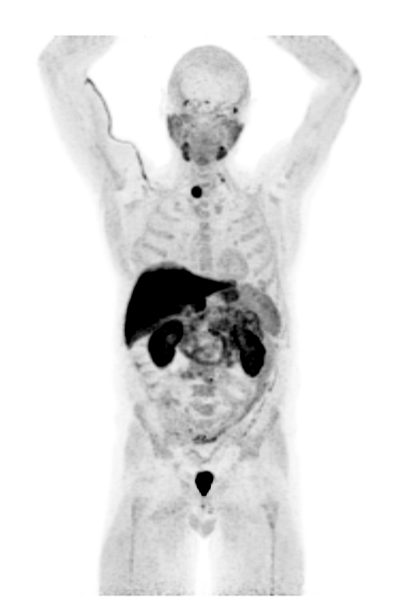
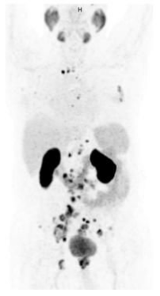
18F-Fluorocholine
68Ga/18F-PSMA
Notes:
Fluorocholine is a PET tracer formerly used in restaging prostate cancer.
It has been replaced by gallium PSMA or fluorine PSMA.
Here on the firs image I would like to draw your attention to the first patient, You see a spot of increased choline uptake.

Slide 29
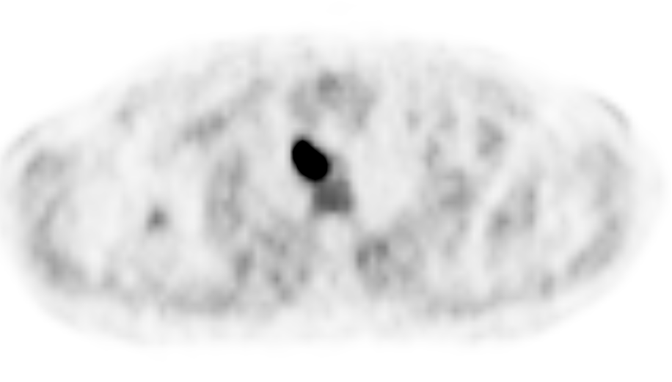
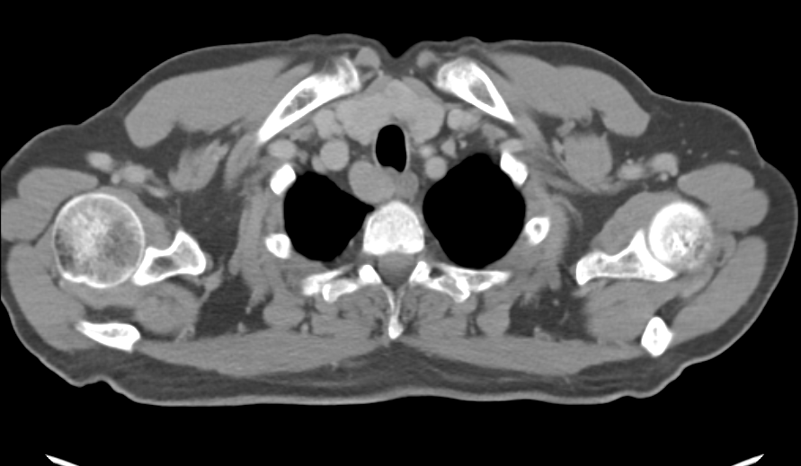
18F-Fluorocholine
Notes:
Here we zoom in on the patiënt. This is an old case from my years as an assistant in UZ Ghent (2017).
This patient had prostate cancer and was scanned due to a elevated PSA.
We detected this choline-absorbing lesion in the neck posterior to the right thyroid lobe.
The patient was referred for further work up and he had a subclinical primary hyperparathyroidism.
This lesion was later confirmed on an additional sestamibi scan as a parathyroid adenoma. This lesion was resected and the patiënt was cured.
This is also how in 2013 the story began of fluorocholine PET/CT in pre-operative localization of hyperfuntional parathyroids.
It was in 2013 the first publication of incidental findings of intense choline-absorbing lesions in the neck area in patients with prostate Ca.

Slide 30
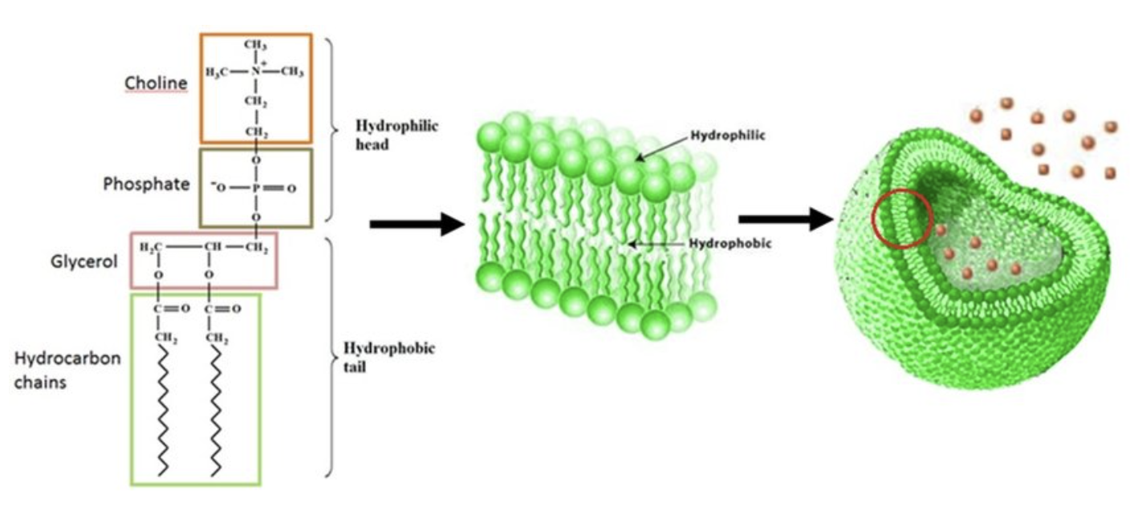
Choline
[
Phosphatidylcholine ➔ Phospholipid bilayer ➔ Cell membrane
© A molecular dynamics investigation of water migration in a lipid bilayer for microalgae drying . Manrique et al. April 2014
Notes:
Choline is part of phosphatidylcholine, wich is a major component of cellular membranes.
Fluorocholine is a cellular proliferation marker incorporated into newly synthesized membrane of rapidly proliferating cells.
Stimulation of phospholipid-dependent choline-kinase results in increased radiolabeled choline uptake and is related to the secretion of PTH in HPT . (eanm guidelines)

Slide 31
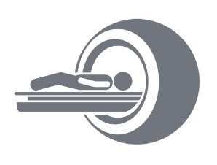
18F-Fluorocholine PET/CT
100 to 300 MBq or 1.5–3.2 MBq/kg of body mass.
5 min
60 min
60 min (2h)
(Rep S et al. Radiol Oncol. 2015)
20 min
(Gauthé M et al. World J Surg. 2020)
Notes:
There are different scan protocols for fluorocholine PET/CT imaging.
Most studies suggest a two time point imaging technique.
A study from 2015 investigated a 3 time point scanning technique. With imaging 5 minutes 1 hour and 2 hours after injection of the radiofarmacuetical. They concluded that the latest images had nog additional value. And that the best immaging time is one hour after injection. Because than you have the best lesion to thyroid contrast. It remains interesting tot do early images if possible beceause leasions with an early wash out are reported.
Another study suggested scanning after 20 minutes with optional late images if the early images are negative.
There still is nog real consesus on what the best imaging technique is. Some say you can do early dynamic scanning followed by late images. There have been reported parathyroid adenoma’s with a fast wash out, a stable uptake and a late uptake.
Better lesion to thyroid contrast on late images, higer parathyroid uptake on early images.
To differentiate parathyroids from lymph nodes look at early dynamic images 2-10 min after injection (lymph nodes flat curve and parathyroid decrease in uptake)
After 10 minutes best parathyroid to thyroid contrast.
The reported mean injected activity of radiolabelled choline ranged from 100 to 370 MBq (in absolute values) and from 1.5 to 3.2 MBq/kg. The time interval between radiotracer injection and image acquisition varied considerably among studies, ranging from 0 to 120 min after injection. (Diagnostic performance of choline PET for detection of hyperfunctioning parathyroid glands in hyperparathyroidism: a systematic review and meta-analysis. 2019 Giorgio Treglia)
recommended imaging time is one hour after the administration of the radiopharmaceutical, and, if possible, preceded by imaging acquired 5 min after the injection (starting as dynamic acquisition and followed by static), as some lesions may show uptake in the early phase only. (Rep S et al. Radiol Oncol. 2015)
One acquisition 20 min after injection with delayed images in case of a negative result is also an option (Gauthé M et al. World J Surg. 2020)

Slide 32
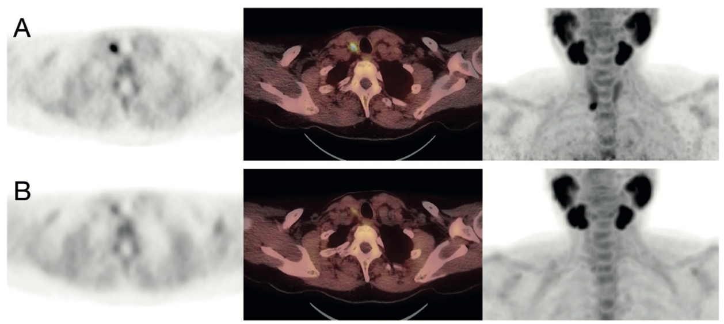
18F-Fluorocholine PET/CT
Broos et al. 2019 Dual time point: 5 min -> 60 min
Better visualization on early images
© Dual-time-point 18F-fluorocholine PET/CT in parathyroid imaging. Broos et al. 2019, Journal of Nuclear Medicine

Slide 33
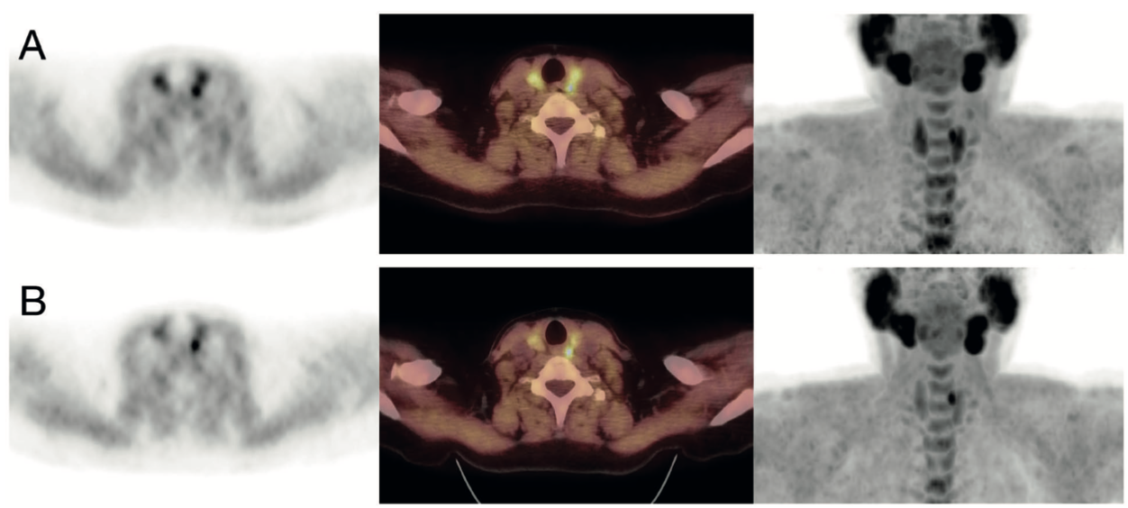
18F-Fluorocholine PET/CT
Broos et al. 2019 Dual time point: 5 min -> 60 min
Better visualization on late images
© Dual-time-point 18F-fluorocholine PET/CT in parathyroid imaging. Broos et al. 2019, Journal of Nuclear Medicine

Slide 34
18F-Fluorocholine PET/CT
Diagnostic performance of choline PET for detection of hyperfunctioning parathyroid glands in hyperparathyroidism: a systematic review and meta-analysis.
Giorgio Treglia & Arnoldo Piccardo & Alessio Imperiale & Klaus Strobel & Philipp A. Kaufmann & John O. Prior & Luca Giovanella
Received: 6 June 2018 / Accepted: 1 August 2018 / Published online: 9 August 2018 # Springer-Verlag GmbH Germany, part of Springer Nature 2018
Conclusions: Radiolabelled choline PET demonstrated excellent diagnostic performance in detecting HP in patients with HPT. Large multicentre studies and cost-effectiveness analyses are needed to better define the role of this imaging method in this setting.
Meta analysis
517 patients
Per-patient analysis: sensitivity 95%, PPV 97% and DR 91%.
Per-lesion analysis: pooled sensitivity 92% and PPV 92%.
Notes:
Flourocholine PET/CT earned ist place in pre-operative parathyroid imaging.
More sensitive than SPECT/ CT especialy in small lesion as seen in hyperplasia.
Wat hieruit opvalt is dat MIBI minder sensitief is maar soms specifieker en Choline duidelijker sensitiever is.
In 2e studie gebruikten ze wel een MIBI SPECT/CT 1 uur na injectie MIBI/tetro (wash out dus, en met tetro kan je geen wash out doen)
Besluit Treglia: Radiolabelled choline PET demonstrated excellent diagnostic performance in detecting HP in patients with HPT. Large multicentre studies and cost-effectiveness analyses are needed to better define the role of this imaging method in this setting.
Besluit Mohsen:In this prospective study, 18F-fluorocholine PET/CT showed promise as a functional imaging modality, being clearly superior to 99mTc-MIBI/tetrofosmin SPECT/CT, especially in the detection and localization of small parathyroid adenomas in patients with primary hyperparathyroidism. However, further evaluation of this modality is needed.
Besluit Bijnens: 18F-Fluorocholine-PET/CT could be shown to be a highly accurate modality to localize parathyroid adenomas preoperatively, obviating the need for total exploration in the majority of patients in whom ultrasound and scintigraphic results are discordant or both negative.
Besluit eanm guidelines: [18F]fluorocholine PET/CT is also considered a potential “alternative” first-line method whenever possible, as it appears to be an effective technique even in patients with negative or equivocal standard imaging findings. (2021 EANM guidelines)
It is particularly useful in patients with sHPT

Slide 35
18F-Fluorocholine PET/CT
18F-Fluorocholine PET/CT in the assessment of primary hyperparathyroidism compared with 99mTc-MIBI or 99mTc-tetrofosmin SPECT/CT: a prospective dual-centre study in 100 patients
Mohsen Beheshti & Lukas Hehenwarter & Zeinab Paymani & Gundula Rendl & Larisa Imamovic & Rupert Rettenbacher & Oleksiy Tsybrovskyy & Werner Langsteger & Christian Pirich
Received: 28 September 2017 / Accepted: 15 February 2018 / Published online: 8 March 2018 # The Author(s) 2018. This article is an open access publication
Conclusion In this prospective study, 18F-fluorocholine PET/CT showed promise as a functional imaging modality, being clearly superior to 99mTc-MIBI/tetrofosmin SPECT/CT, especially in the detection and localization of small parathyroid adenomas in patients with primary hyperparathyroidism. SUVmax was higher in parathyroid adenomas than in hyperplasia. However, further evaluation of this modality is needed.
Prospective
82 patiënts
Patient-based analysis: Detection rate PET/CT 93% vs MIBI 61%.
Lesion-based analysis: the sensitivity PET/CT 93.7% vs MIBI 60.8%, specificity PET/CT 96% vs MIBI 98.5%, positive predictive value PET/CT 90.2% vs MIBI 94.1%., negative predictive value PET/CT 97.4% vs MIBI 86.3%, overall accuracy PET/CT 95.3% vs MIBI 87.7%.
Notes:
Wash out parathyroid scintigraphy
Flourocholine PET/CT earned ist place in pre-operative parathyroid imaging.
More sensitive than SPECT/ CT especialy in small lesion as seen in hyperplasia.
Wat hieruit opvalt is dat MIBI minder sensitief is maar soms specifieker en Choline duidelijker sensitiever is.
In 2e studie gebruikten ze wel een MIBI SPECT/CT 1 uur na injectie MIBI/tetro (wash out dus, en met tetro kan je geen wash out doen)
Besluit Treglia: Radiolabelled choline PET demonstrated excellent diagnostic performance in detecting HP in patients with HPT. Large multicentre studies and cost-effectiveness analyses are needed to better define the role of this imaging method in this setting.
Besluit Mohsen:In this prospective study, 18F-fluorocholine PET/CT showed promise as a functional imaging modality, being clearly superior to 99mTc-MIBI/tetrofosmin SPECT/CT, especially in the detection and localization of small parathyroid adenomas in patients with primary hyperparathyroidism. However, further evaluation of this modality is needed.
Besluit Bijnens: 18F-Fluorocholine-PET/CT could be shown to be a highly accurate modality to localize parathyroid adenomas preoperatively, obviating the need for total exploration in the majority of patients in whom ultrasound and scintigraphic results are discordant or both negative.
Besluit eanm guidelines: [18F]fluorocholine PET/CT is also considered a potential “alternative” first-line method whenever possible, as it appears to be an effective technique even in patients with negative or equivocal standard imaging findings. (2021 EANM guidelines)
It is particularly useful in patients with sHPT

Slide 36
18F-Fluorocholine PET/CT
Retrospective real‐life study on preoperative imaging
for minimally invasive parathyroidectomy in primary hyperparathyroidism
Jacqueline Bijnens, Annick Van den Bruel , Vincent Vander Poorten,
Ingeborg Goethals , Steven Van Schandevyl , Catherine Dick & Frank De Geeter
www.nature.com/scientificreports/ (2022) 12:17427
18F‐Fluorocholine‐PET/CT could be shown to be a highly accurate modality to localize parathyroid adenomas preoperatively, obviating the need for total exploration in the majority of patients in whom ultrasound and scintigraphic results are discordant or both negative.
Retrospective
104 patiënts (97 MIBI and 30 PET/CT)
Sensitivity PET/CT 90% vs. MIBI 57%
Specificity PET/CT 90% vs. MIBI 97%
Notes:
Flourocholine PET/CT earned ist place in pre-operative parathyroid imaging.
More sensitive than SPECT/ CT especialy in small lesion as seen in hyperplasia.
Wat hieruit opvalt is dat MIBI minder sensitief is maar soms specifieker en Choline duidelijker sensitiever is.
In 2e studie gebruikten ze wel een MIBI SPECT/CT 1 uur na injectie MIBI/tetro (wash out dus, en met tetro kan je geen wash out doen)
Besluit Treglia: Radiolabelled choline PET demonstrated excellent diagnostic performance in detecting HP in patients with HPT. Large multicentre studies and cost-effectiveness analyses are needed to better define the role of this imaging method in this setting.
Besluit Mohsen:In this prospective study, 18F-fluorocholine PET/CT showed promise as a functional imaging modality, being clearly superior to 99mTc-MIBI/tetrofosmin SPECT/CT, especially in the detection and localization of small parathyroid adenomas in patients with primary hyperparathyroidism. However, further evaluation of this modality is needed.
Besluit Bijnens: 18F-Fluorocholine-PET/CT could be shown to be a highly accurate modality to localize parathyroid adenomas preoperatively, obviating the need for total exploration in the majority of patients in whom ultrasound and scintigraphic results are discordant or both negative.
Besluit eanm guidelines: [18F]fluorocholine PET/CT is also considered a potential “alternative” first-line method whenever possible, as it appears to be an effective technique even in patients with negative or equivocal standard imaging findings. (2021 EANM guidelines)
It is particularly useful in patients with sHPT

Slide 37
18F-Fluorocholine PET/CT
Pro’s and Con’s
Benefits vs conventional 99mTc-sestamibi SPECT/CT:
Shorter acquisition time
Lower radiation dose
Higher spatial resolution (analogic vs digital scanner, detection lesions < 10mm)
Better performance in benign nodular thyroid disease
(No need to stop calcimimetic drugs)
Pitfall:
Tracer uptake in lymph nodes (false-positive results ectopic locations)
Nonspecific uptake of choline, which also accumulates in malignancies and reactive tissue (thyroid cancer/ adenoma (reference to thyroid scintigraphy advised).
Higher cost
Only in selected centers
Notes:
The impact of the performance of the PET/CT machine on the performance of [ 18F]fluorocholine imaging. analogic scanner vs digital scanner. analogic scanner could detect hyperfunctioning tissue in 22 of 33 of patients with negative or inconclusive [99mTc]Tc-MIBI SPECT/CT, while a digital scanner detected hyperfunctioning tissue in 30 of 33 patients. lesions detected only by the digital system were < 10 mm in diameter on resection, highlighting the potential importance of new PET/CT technologies in the detection of small parathyroid lesions. López-Mora DA, Sizova M, Estorch M, Flotats A, Camacho V, Fernández A, et al. Superior performance of 18F-fluorocholine digital PET/CT in the detection of parathyroid adenomas.
Uit doktoraat
Choline is an nonspecific tracer for cell proliferation, and thus it also accumulates in malignancies and inflammation, which may yield false-positive results.[16,47] Several of the analyzed studies found false-positive intrathyroidal uptake, representing thyroid cancer (four cases in Michaud et al.[22], one case in Thanseer et al.[32], and an unspecified number in Parvinian et al.[33]). It must be noted that parathyroid adenoma can be localized intrathyroidal, which has earlier been reported with choline PET/CT.[48] A frequent cause of decreased performance in US and 99mTc-sestamibi scintigraphy is benign nodular thyroid disease but this is less of a problem in choline PET/CT.[35,49,50]
Fluorocholine effective dose of 6 mSv and dual isotope around 8 mSv

Slide 38
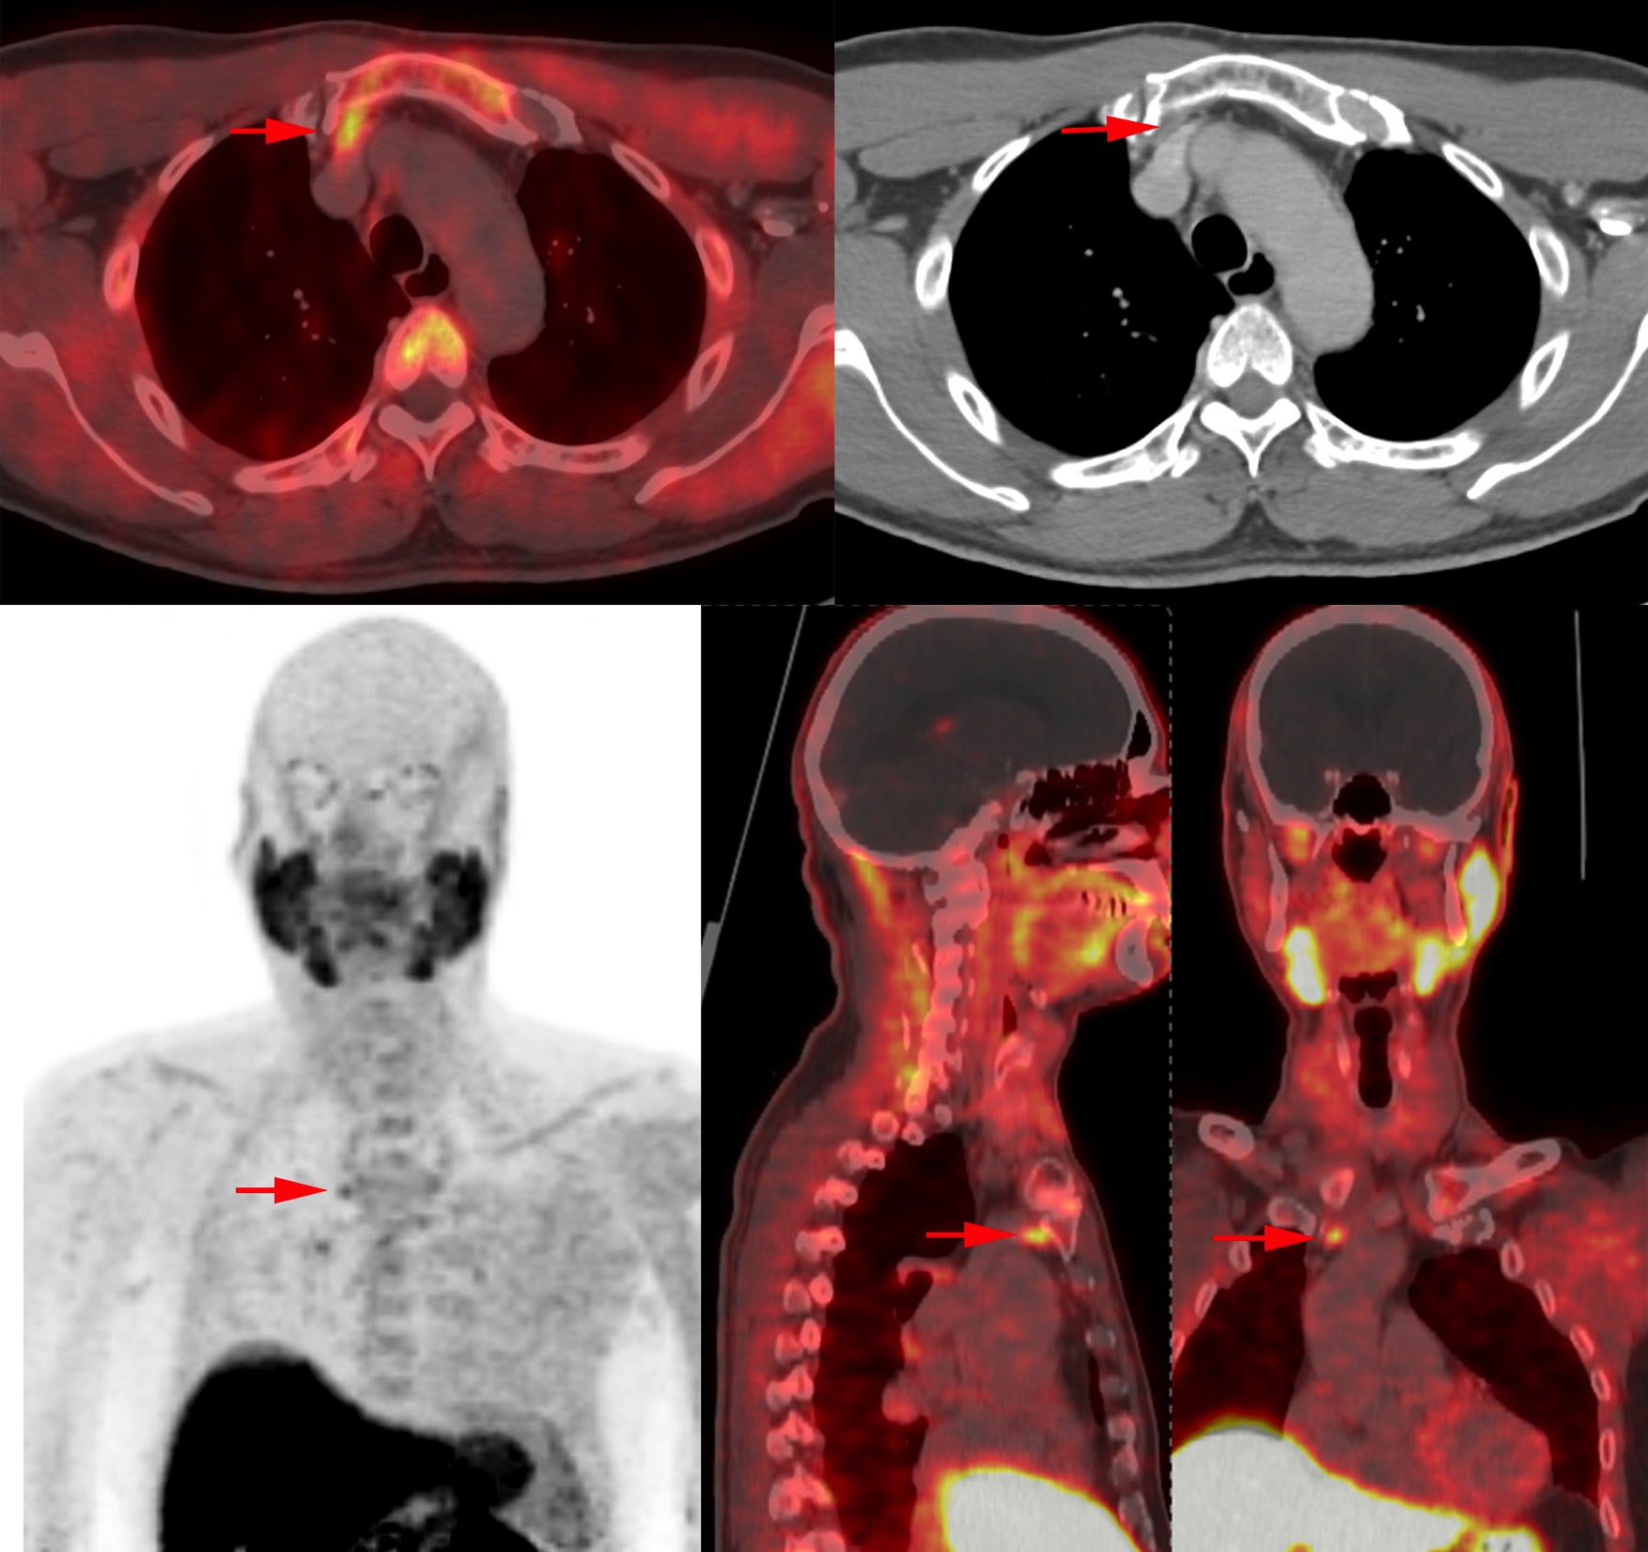
Notes:
This 60-year-old man
was referred to us from an outside hospital.
He was diagnosed with an asymptomatic primary hyperparathyroidism on a routine check-up.
No parathyroid adenoma was visualized on ultrasound of the neck.
The 99mTc- sestaMIBI scintigraphy with SPECT/CT was inconclusive with on the subtraction image an irregular drawing caudally of the left thyroid lobe and an ectopic focus parasternal to the left.
18F-Fluorocholine PET/CT scan was performed with visualization of an ectopic choline capturing lesion right posterior to the manubrium sterni.
During surgery, a disc-shaped parathyroid adenoma could be found in the thymus tissue.

Slide 39
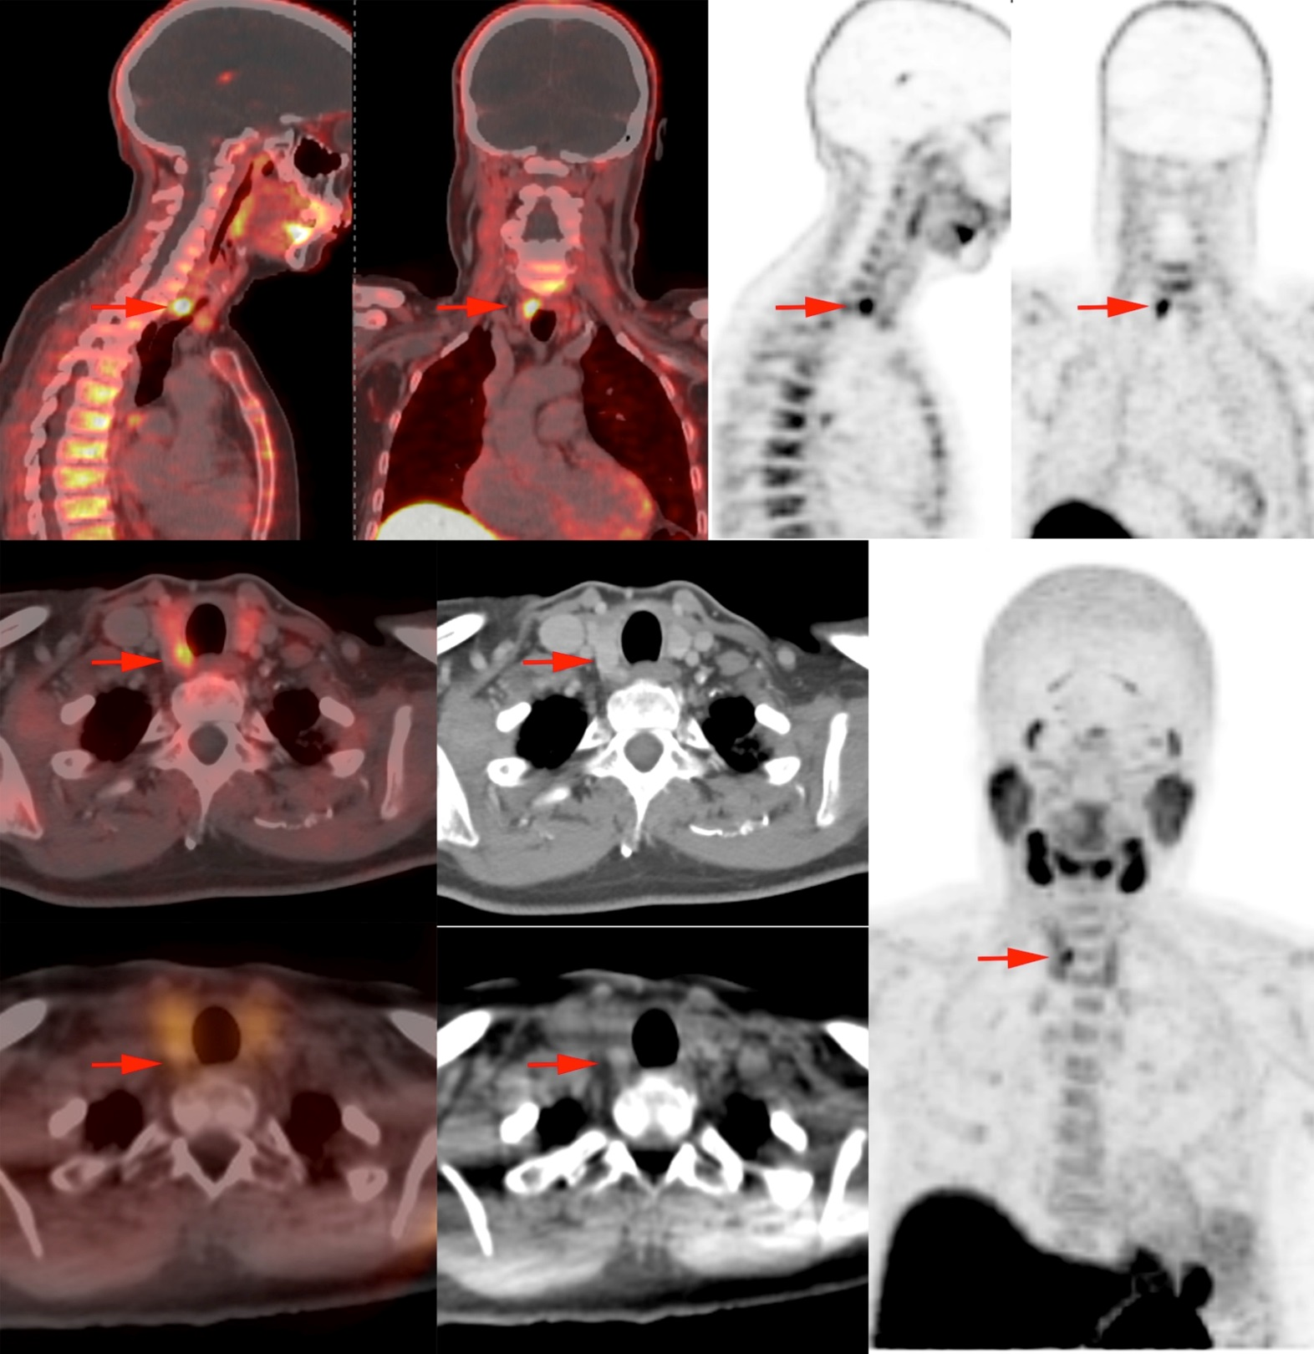
Courtesy of AZ Jan Palfijn Ghent
Notes:
This 62-year-old lady
was referred from an outside hospital
She had a long-standing problem of kidney stones and was diagnosed primary hyperparathyroidism,
neck ultrasound suggested a lesion on the left and 99mTc-sestaMIBI scintigraphy was negative
18F-Fluorocholine PET/CT scan was performed with visualization of a strong choline-capturing lesion posterior to the right thyroid lower pole.
This lesion could be resected and was confirmed by the pathologist as a parathyroid adenoma.
In this patient, the right thyroid lobe was also removed because of a multinodularly transformed thyroid gland with several potentially suspicious nodules in the right lobe.
Maybe this was the underlying cause of the negative sestamibi scan.

Slide 40
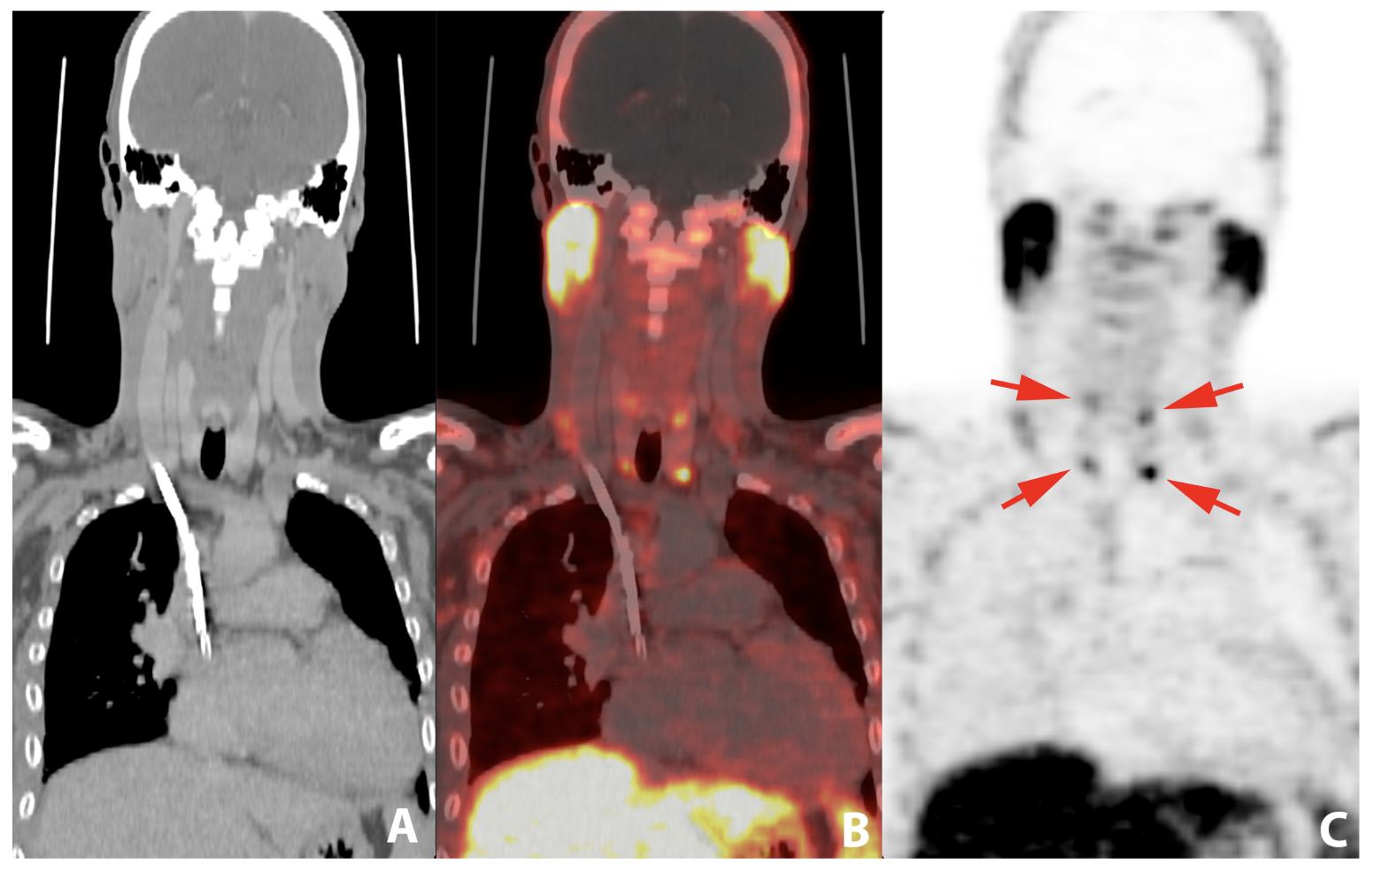
Notes:
This 35-year-old man
had end-stage renal failure due to HIV associated nephropathy
Who already lost a kidney transplant and was now treated with dialysis.
He was referred for an 18F-Fluorocholine PET/CT scan becouse he had an substantial secondary hyperparathyroidism.
Here you can clearly see the 4 hyperplastic parathyroids.
The patient underwent a 3 + 1/2 resection of the hyperfunctioning glands and pwas cured.

Slide 41
Notes:
Thank you for the attention and remind you to be greatfull of the sacrifice the Indian rhino made for science.

